Slide 1
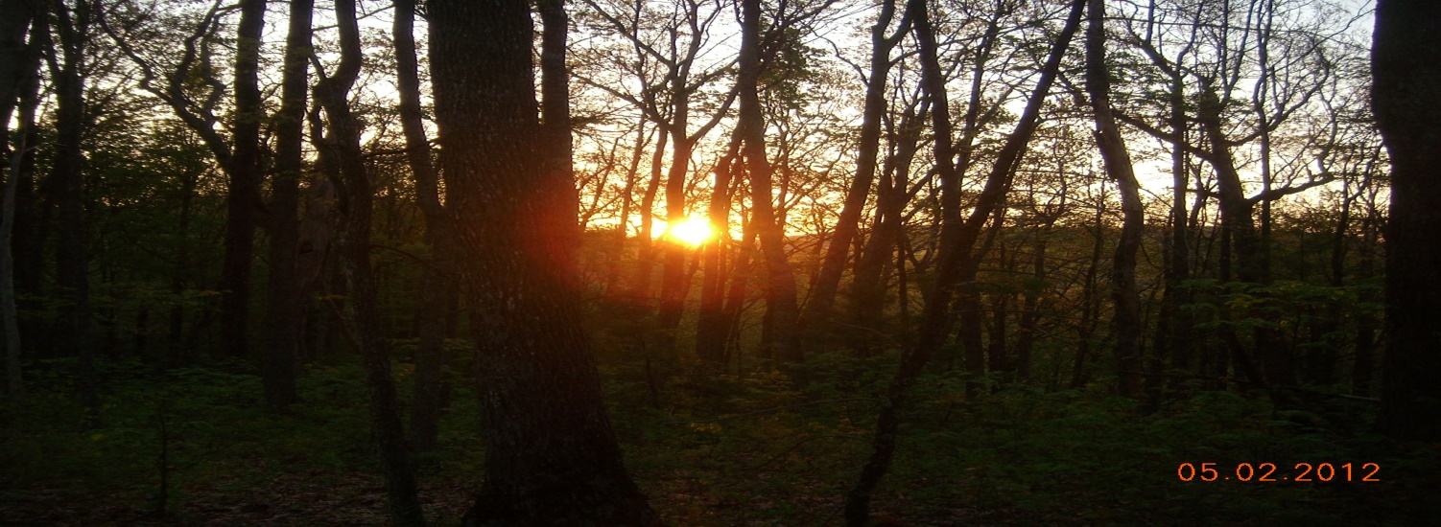
Seeking Genes Governing
Anomalous Experience:
Correlational Mapping of
Community Survey Data
(James McClenon)

Slide 2
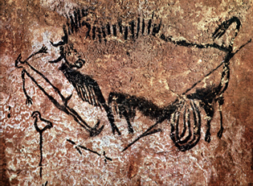
Seeking ESP genes
Shamanic art
(about 20,000 BP)
Most psychological traits have genetic basis
The propensity for anomalous experience and shamanism seem to have genetic basis
Shamanism and anomalous experience probably have had evolutionary impact

Slide 3
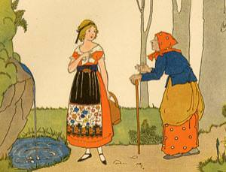
Genetic Basis for ESP
Many folklore traditions describe ESP as inherited.
Cohn (1999) verified the genetic basis for ESP experiences within a Scottish sample.

Slide 4
Gene Hunting Strategy
(Pearlson and Folley, 2008)
1. Devise evolutionary theories (we will use 2 theories)
2. Identify phenotypic markers (questionnaire items)
3. Conduct a community survey.
4. Analyze results using correlational mapping: cluster configurations imply underlying alleles (genes that vary)
5. Revise theories/markers in response to findings
6. Obtain DNA from individuals with phenotypic markers
7. Obtain DNA from first-order relatives lacking markers
8. Compare DNA to locate alleles.
9. Use reverse phenotyping.

Slide 5
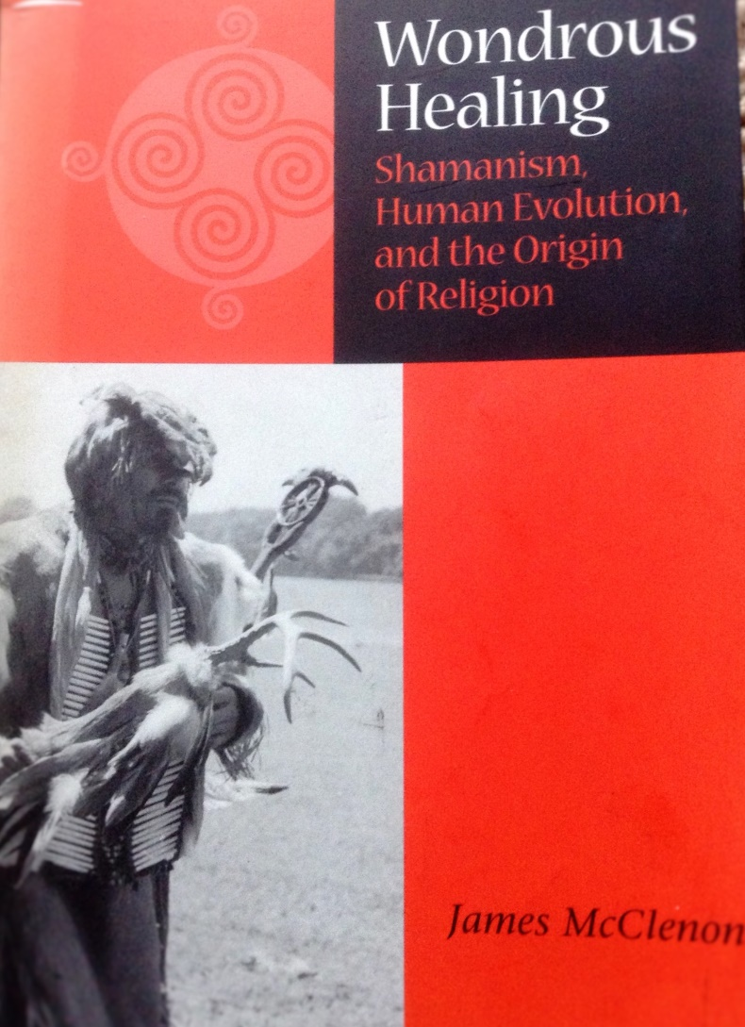
Research Plan
Devise evolutionary theories explaining anomalous experience
Identify common unusual experiences
Devise questionnaire items measuring experience incidence
Administer questionnaire to community sample
Correlational mapping analysis
Revise theories if required

Slide 6

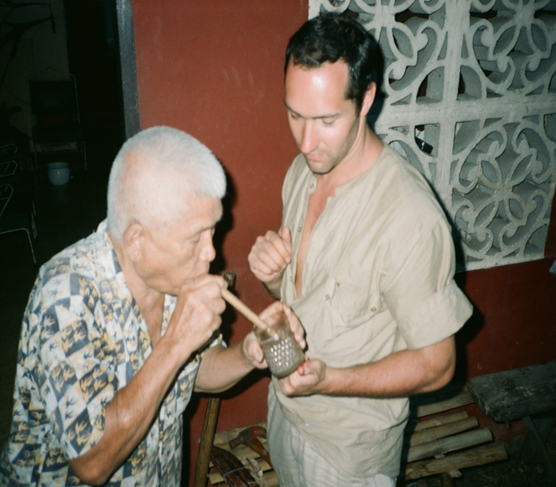
Study of shamanic practitioners
(1982-1986: Okinawa, Thailand, Korea, Japan, Philippines, Sri Lanka, India, China, Taiwan; McClenon, 1994)
All shamans described spontaneous anomalous experiences as central with their biographies.
All shamanic rituals involved hypnotic suggestion and placebo effects.

Slide 9

North Carolina Folklore Research (1988-1996)
Determining Experiential Forms
Respondents were asked, “If you have had a very unusual experience, would you describe it?”
1578 narratives collected
Questionnaire items designed based on response categories

Slide 10

Unusual experience questions
(How often have you had the following experiences?)
apparitions
waking ESP
paranormal dreams
out-of-body experiences
near-death experiences
sleep paralysis
spiritual healing
psychokinesis
UFOs
religious experiences
other (déjà vu, omens, synchronicity, etc.)

Slide 11
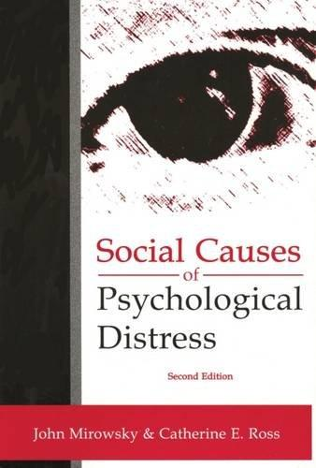
Mirowsky and Ross (1989)
Mirowsky and Ross (1989) used correlational mapping to portray the configuration of 81 psychological symptoms (11 diagnostic categories)

Slide 12
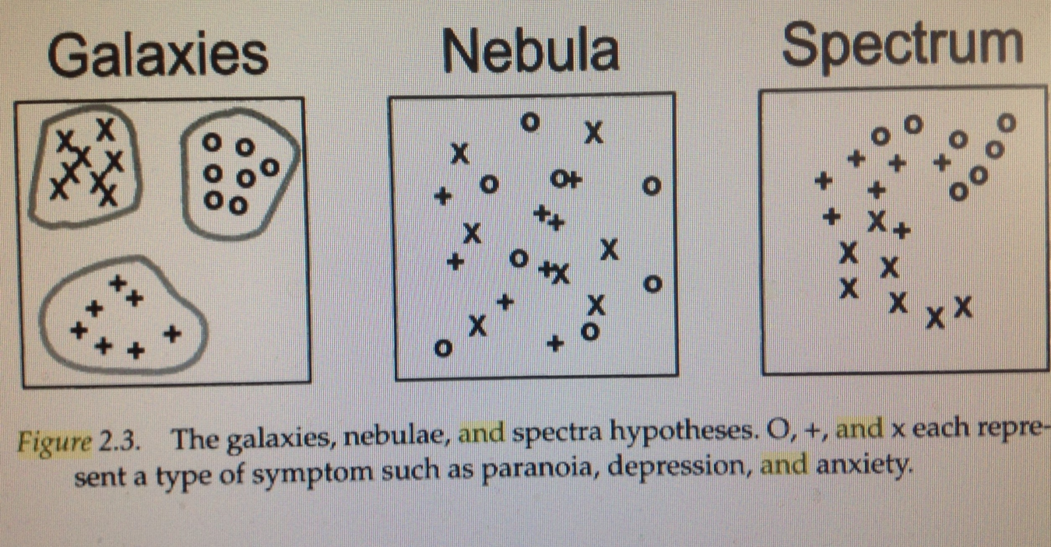
Social Causes of Psychological Distress
Mirowsky and Ross (1989)
Example: paranoia (X), depression (0), and anxiety (+)
*A galaxy configuration implies categories do not share alleles.
*A nebula configuration implies categories share alleles
*A spectrum configuration implies that some other variable causes these categories to be highly correlated.

Slide 13
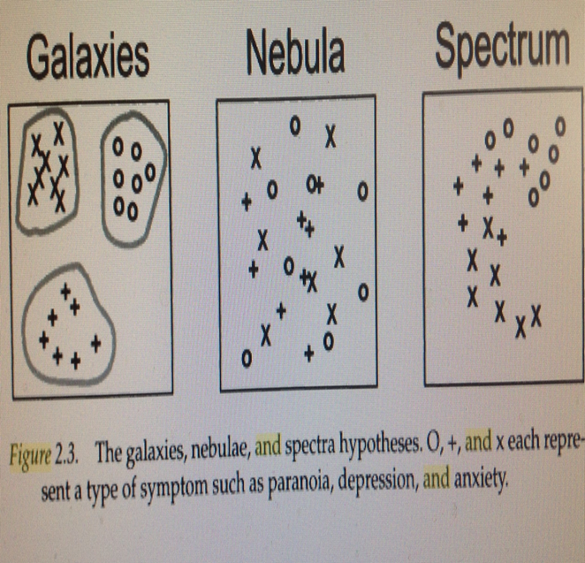
Correlational mapping analysis
X = anomalous experience
0 = psychological symptoms
+ = shamanic variables
*A galaxy configuration implies categories do not share alleles.
*A nebula configuration implies categories share alleles
*A spectrum configuration implies that some other variable causes these categories to be highly correlated.

Slide 14
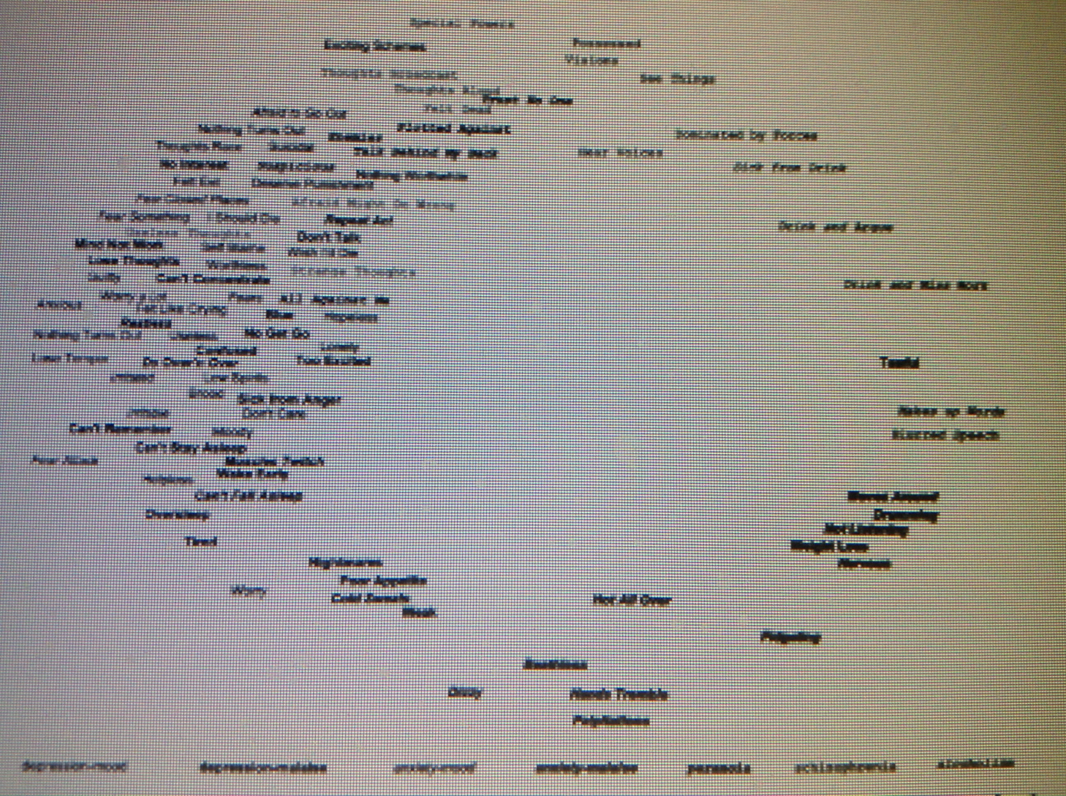
Correlational map supports
(nebula: diagnostic categories overlap)

Slide 15

Where will anomalous experiences be located on this correlational map?
Galaxy? Nebula? Spectrum?

Slide 16
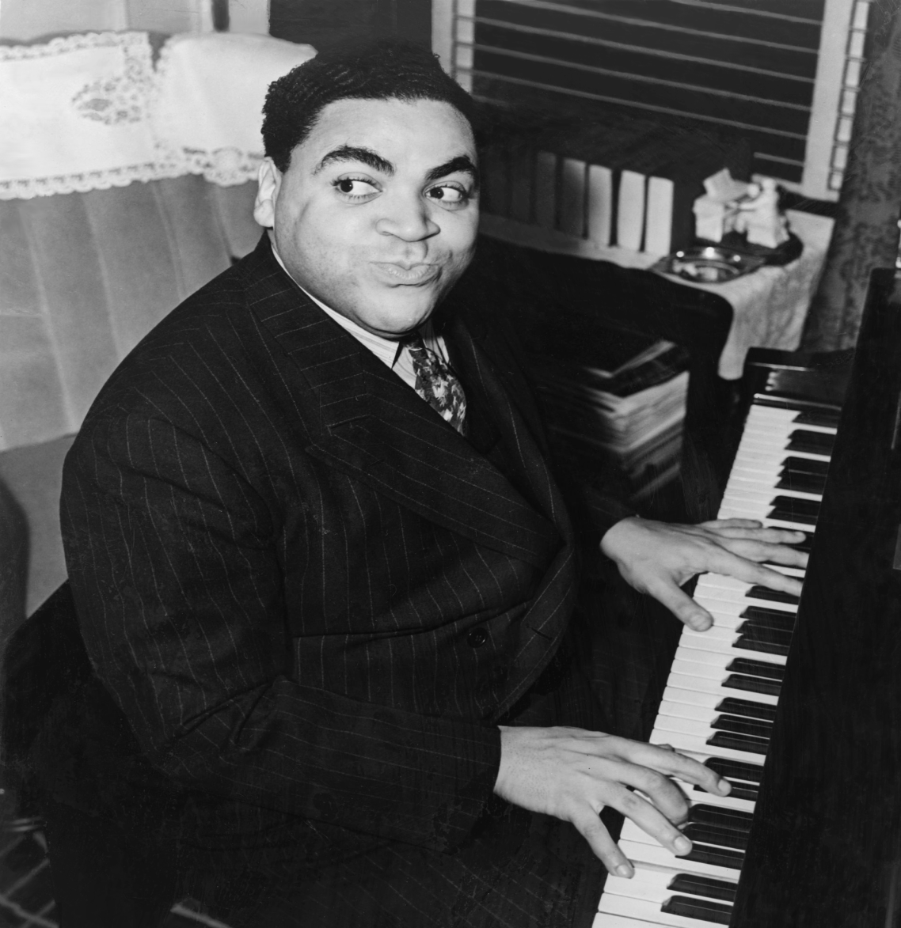
One never knows, does one?
(Fats Waller)

Slide 17
Study Questionnaire
Unusual experience variables
Psychological symptoms (Mirowsky and Ross, 1989)
Shamanic variables (Tellegen Absorption Scale and selected variables from the Dissociation Experience Scale, Transliminality Scale, Boundary Questionnaire)
Variables predictive of psychopathology (childhood difficulty, adolescence difficulty, Satisfaction with Life Scale, Hostility Scale, John Henry Scale, gender, age, ethnicity, employment, high blood pressure, income)

Slide 18

Questionnaire Administration (2001-2007)
Students gave questionnaires to family, friends, and neighbors.
Sample characteristics
N=865
73% African-American; 26% Caucasian
69% female; 31% male
Median annual family income = $27,372
Bottom quartile in USA

Slide 19
Survey Results:
Unusual Experience Incidence
% of respondents reporting
1. Paranormal dreams 66%
2. Apparitions 40%
3. Spiritual healing 35%
4. Sleep paralysis 35%
5. Psychokinesis 34%
6. OBE 29%
7. Religious experience 23%.
8. Other 22%
9. Waking ESP 21%
10. NDE 14%
11. UFO 10%

Slide 20
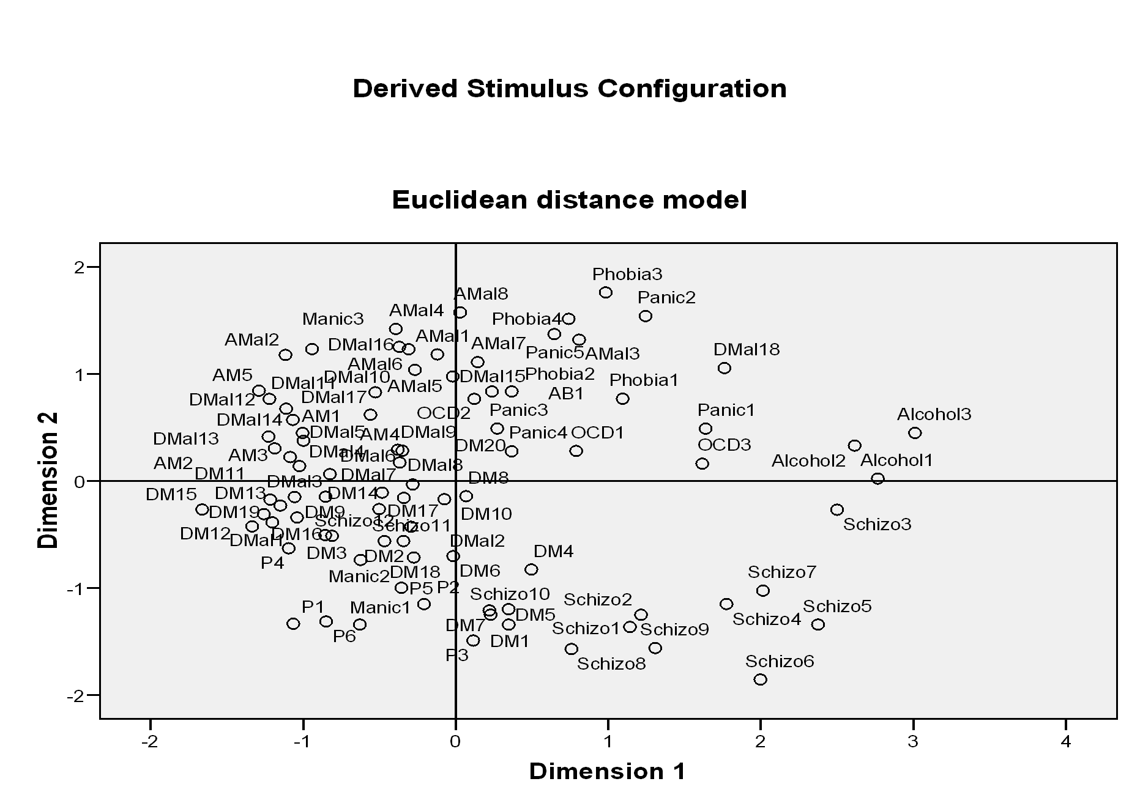
Replication of Mirowsky and Ross symptom wheel (nebula)
Where will unusual experiences be located on this map?

Slide 21
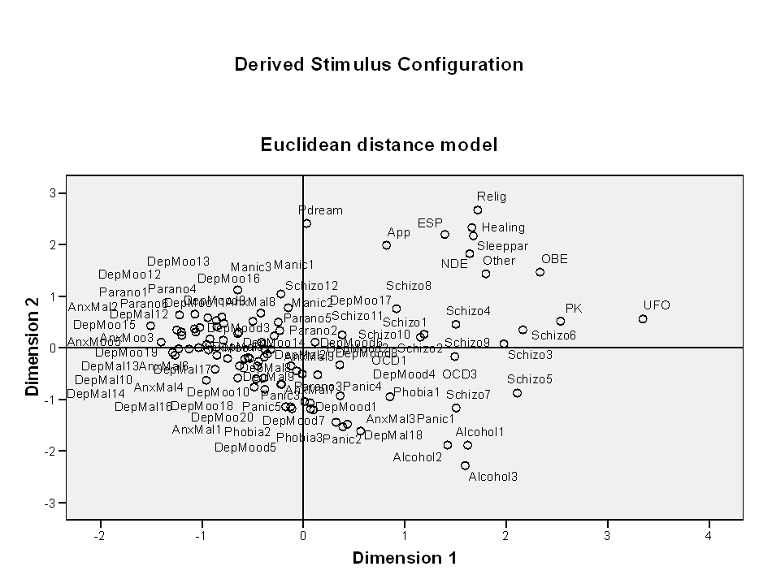
Correlational Mapping:
Psychological symptoms and unusual experiences
(Spectrum configuration)

Slide 22
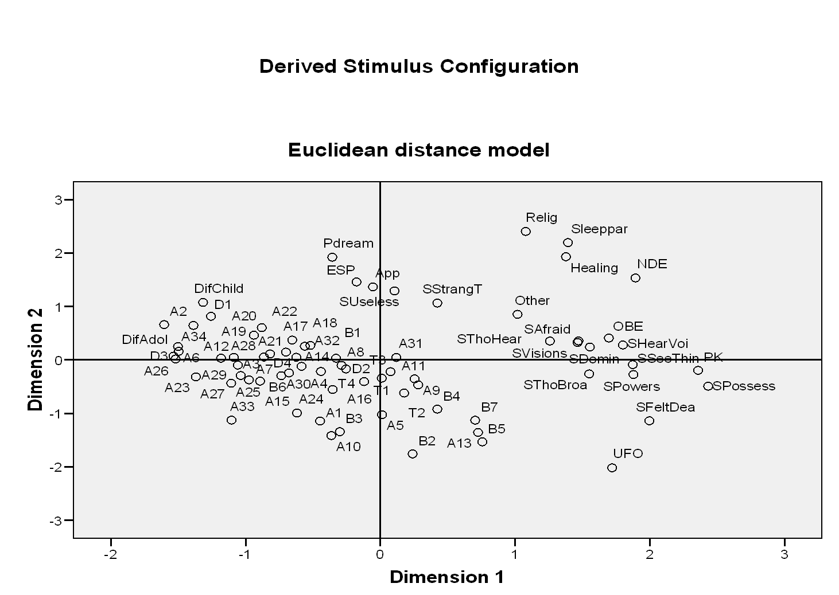
Schizophrenia symptoms, shamanic variables, unusual experiences (Spectrum configuration)

Slide 23
Findings
The spectrum configuration supports the ritual healing theory.
Childhood trauma/stress probably causes high correlations among schizophrenia symptoms, shamanic variables, propensity for unusual experiences.
Unusual experiences do not share alleles with shamanic variables or schizophrenia symptoms.

Slide 24
Correlational cluster analysis
(What is clustered with ESP?)
Waking ESP, paranormal dreams, apparitions
Possible shared allele

Slide 25
Alternate clusters: (1)waking ESP, apparitions, OBE (2) waking ESP, apparitions, OBE, apparitions, paranormal dreams, and “other”
Suggested phenotypic markers: waking ESP, apparitions, paranormal dreams, OBE (coincides with ritual healing theory)
NOTE: ESP and PK are not clustered(“psi” is not a valid concept.)

Slide 26
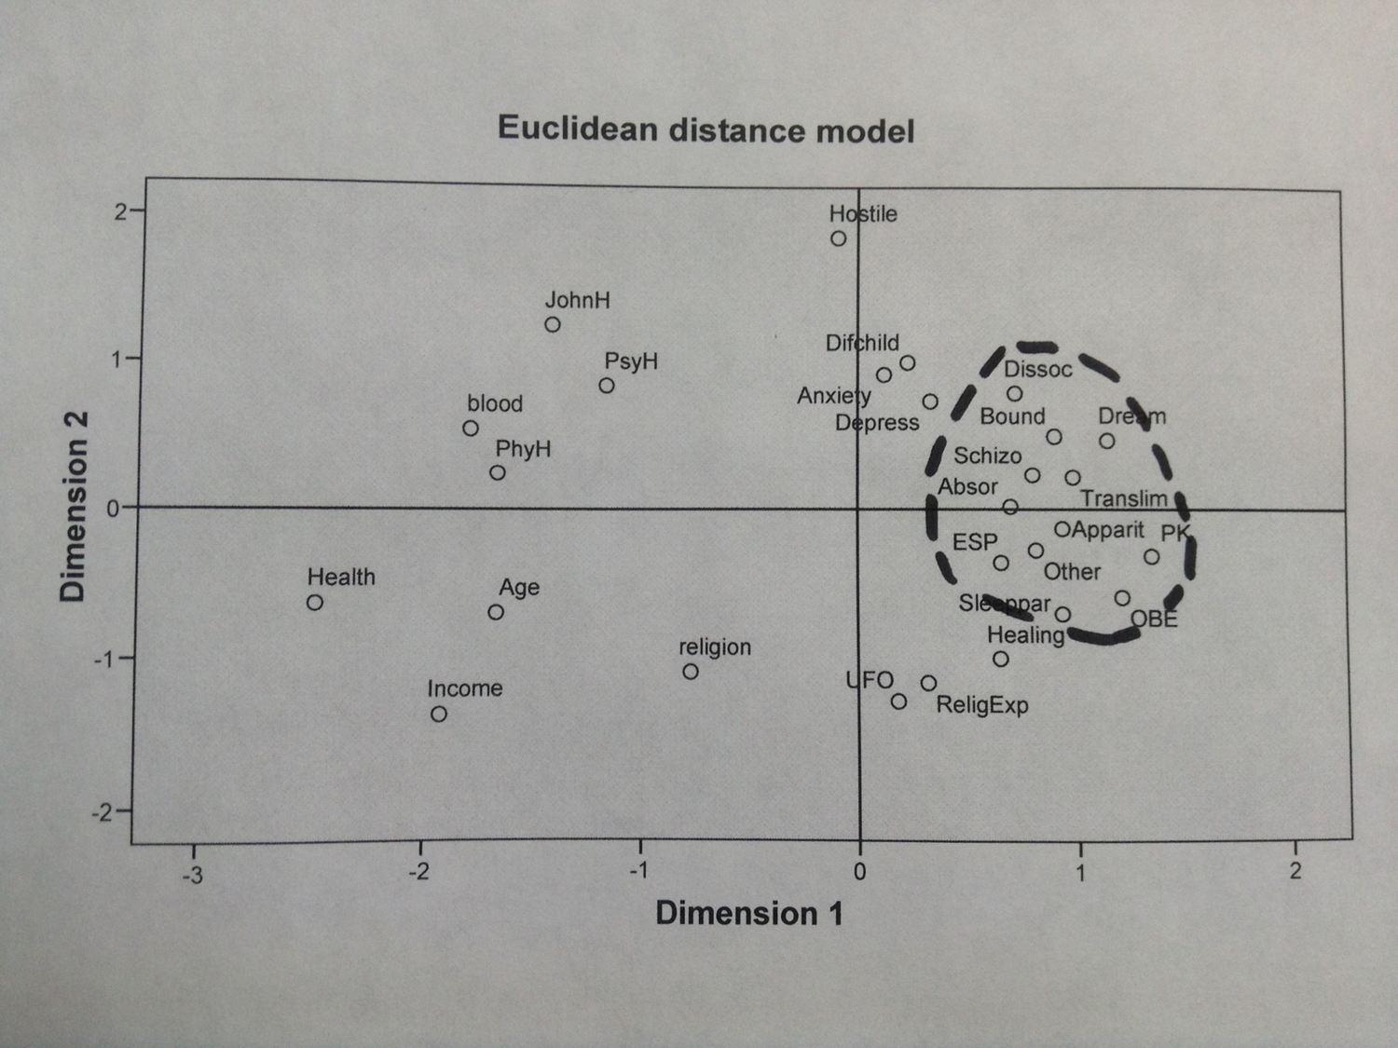
Variables predictive of psychological symptoms, psychological symptoms, unusual experiences, shamanic variables

Slide 27
Special Issues
Researchers have failed to locate major schizophrenia alleles.
Ott, et al. (2005) located a gene associated with the Tellegen Absorption Scale (this supports the ritual healing theory)

Slide 28
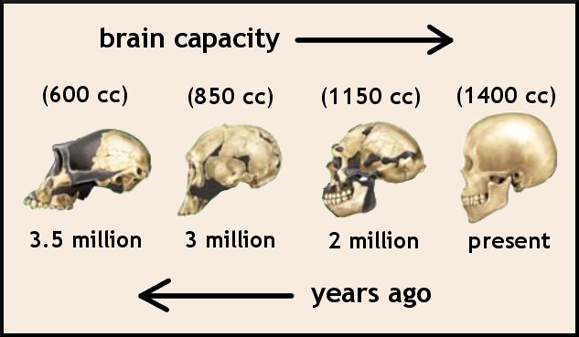
Polygenic Mutation Selection Theory
Keller and Miller (2006) hypothesize that consciousness has an evolutionary “added on” characteristic.
A series of modules have been added during the evolutionary process.
Random mutations disrupting earlier modules cause dysfunctions in later modules.

Slide 29
Schematic view of consciousness: random mutation causes cascade of dysfunctions within later modules
ESP PK psychosis other disorders
later
modules
Absorption,
Shamanic
variables
random mutation earliest
module

Slide 30
Polygenic mutation selection theory
The polygenic mutation selection theory explains the genetic basis, universal features, sporadic nature, and ongoing incidence of certain mental disorders.
The polygenic mutation selection theory explains the genetic basis, universal features, sporadic nature, ongoing incidence, and correlation with psychosis of anomalous experiences – assuming that a disruption of normal consciousness facilitates anomalous perception.
A revised theory coincides with the Ganzfeld paradigm regarding ESP.

Slide 31
Sheep Theory
(caution: see McClenon, 2002)
ESP ESP Evolutionary
alleles experiences benefits

Slide 32
Revised Ritual Healing Theory

Slide 33
Revised Ritual Healing Theory
Stress/trauma Shamanic variables
Psychosis, other schizotypy unusual mystical
pathologies experiences experiences
Random mutations Socialization
Shamanism

Slide 34
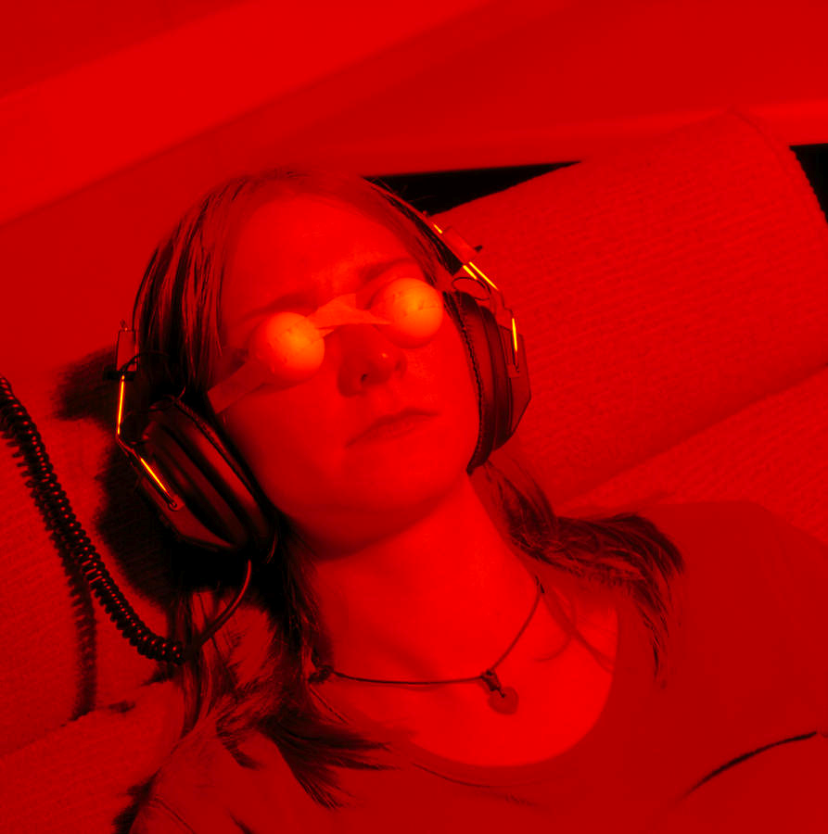
Ganzfeld and Eastern Traditions
The Ganzfeld Experiment: normal consciousness inhibits reception of extrasensory information.
Eastern mystical traditions: normal consciousness clouds perception of ultimate reality.

Slide 35
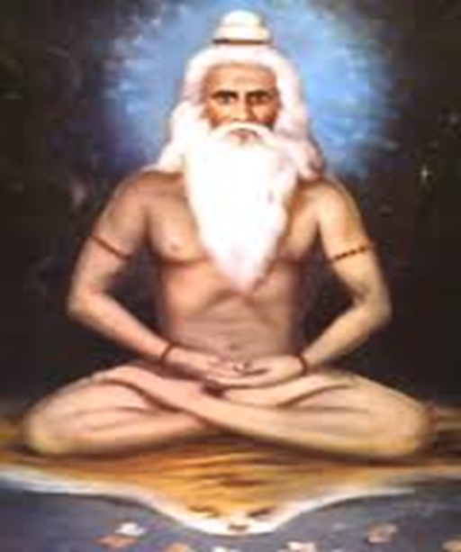
An extension of this paradigm
Random mutations disrupt normal consciousness.
Shamanic propensities have evolved to cope with these disruptions (wounded healer syndrome)
Cognitive disruptions facilitate anomalous experience.

Slide 37
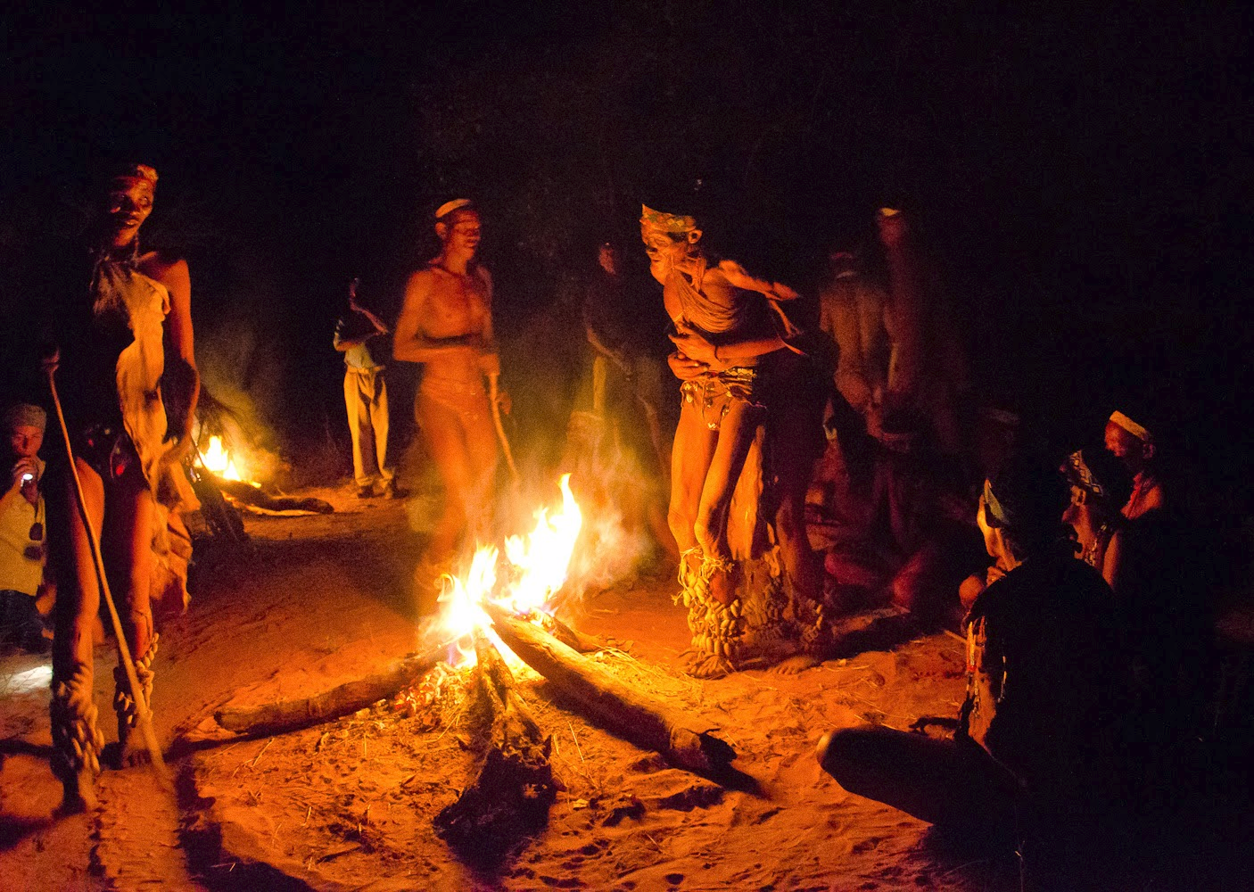

Slide 38
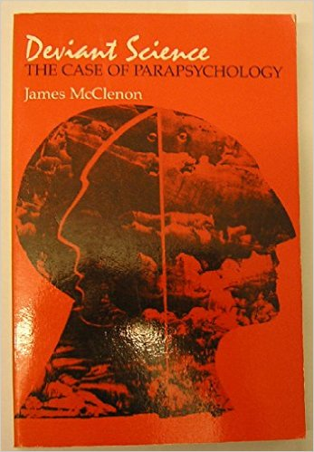

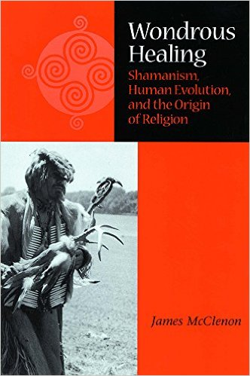

Slide 39
References
Cohn, S. A. (1999). Second sight and family history: Pedigree and segregation analysis. Journal of Scientific Exploration, 13, 351-371.
Cooper, G. and Thalbourne, M. A. (2005). McClenon’s ritual healing theory: An exploratory study, Journal of Parapsychology, 69, 139-150.
James, S. (1994). John Henryism and the health of African-Americans. Culture, Medicine, and Psychiatry, 18: 163-182.
Keller, M. C. & Miller, G. (2006). Resolving the paradox of common, harmful, heritable mental disorders: Which evolutionary genetic models work best? Behavioral and Brain Sciences, 29, 385-404; discussion; 405-52.
Lange, R., Thalbourne, M. A., Houran, J., & Storm, L. (2000). The revised Transliminality Scale: Reliability and validity data from a Rasch top-down purification procedure. Consciousness and Cognition, 9, 591-617.

Slide 40
References
McClenon, J. (1993) The experiential foundations of shamanic healing. Journal of Medicine and Philosophy, 18: 107-127.
McClenon, J. (1994). Wondrous events: Foundations of religious belief. Philadelphia: University of Pennsylvania Press.
McClenon, J. (1997). Shamanic healing, human evolution, and the origin of religion. Journal for the Scientific Study of Religion, 36, 345-354.
McClenon, J. (2002a). Wondrous healing: Shamanism, human evolution, and the origin of religion. DeKalb, IL: Northern Illinois University Press.
McClenon, J. (2002b), Content analysis of an anomalous experience collection: Evaluating evolutionary perspectives. Journal of Parapsychology, 66, 291-315.
McClenon, J. M. (2011). Evolutionary Theories of Schizophrenia: An Experience-Centered Review, Journal of Mind and Behavior, 32, 2011, 135-150.
McClenon, J. M. (2012). A Community Survey of Psychological Symptoms: Evaluating Evolutionary Theories Regarding Shamanism and Schizophrenia, Mental Health, Religion & Culture, 15, 2012, 799-816.
McClenon, J. (2013). A Community Survey of Anomalous Experiences: Correlational Analysis of Evolutionary Hypotheses, Journal of Parapsychology, 77, 2013, 55-78.

Slide 41
References
.
Mirowsky, J. & Ross, C. E. (1989a). Social causes of psychological distress. Hawthorne, NY: Aldine de Gruyter
Ott, U., Reiter, M., Henning, J., Vaitl, D. (2005). Evidence for a common biological basis of the absorption trait, hallucinogen effects, and positive symptoms: Epistasis between 5-HT2a and COMT polymorphism, American Journal of Medical Genetics, Part B: Neuropsychiatric Genetics, 137B, 29-32.
Pearlson, G. D. & Folley, B. S. (2008). Schizophrenia, psychiatric genetics, and Darwinian psychiatry: An evolutionary framework. Schizophrenia Bulletin, 34, 722-733.
Tellegen, A. & Atkinson, G. (1974). Openness to absorbing and self-altering experiences (“ab-sorption”), a trait related to hypnotic susceptibility. Journal of Abnormal Psychology, 83, 268-77.
Thalbourne, M. A. & Delin, P. S. (1994). A common thread underlying belief in the paranormal, creative personality, mystical experience, and psychopathology. Journal of Parapsychology, 58, 3-38.
Williams, R. & Williams, V. (1994). Anger kills: Seventeen strategies for controlling the hostility that can harm your health. New York: HarperPerennial.

Slide 42
Unusual Experience Questions
Respondents were asked, “How often have you had the following experience?” and provided the list: (1) Apparition (perceiving something through sight, sound, or touch that you later found was not completely real), (2) Waking ESP (perceiving something using a “sixth sense”), (3) Paranormal dream (having a dream that you later found reflected actual events), (4) Out-of-body experience (having the feeling that you were out of your body) (5) Near-death experience (unusual perceptions during a time you thought you were close to death), (6) Psychokinesis (perceiving that an object moved magically), (7) Sleep paralysis (waking from sleep and finding that you could not move), (8) Spiritual healing (being healed through a method not verified by modern medicine), (9) UFO (unidentified flying object in the sky), (10) Other type of extremely unusual experience, (11) Religious experience.
Respondents were provided 3 frequency choices: “never,” “once or twice,” or “more often.”

Slide 43
Schizophrenia symptoms
S1: Felt that your mind was dominated by forces beyond your control
S2: Heard voices without knowing where they came from
S3: Seen things or animals or people around you that others did not see
S4: Had visions or seen things other people say they cannot see
S5: Felt that you were possessed by a spirit or devil
S6: Felt you had special powers
S7: Felt that you did not exist at all, that you were dead, dissolved
S8: Seemed to hear your thoughts spoken aloud - almost as if someone standing nearby could hear them
S9: Felt that your unspoken thoughts were being broadcast or transmitted, so that everyone knew what you were thinking
S10: Felt afraid that you might do something seriously wrong against your own will
S11: Had unusual thoughts that kept bothering you
S12: Had useless thoughts that kept running through your mind

Slide 44
Phobia
Phobia1 Had a sudden feeling, not based on a real cause, of intense apprehension, fearfulness or terror
Phobia2: Felt you must avoid certain places or situations from which escape might be difficult or embarrassing
Phobia3: Had an unreasonable fear, not associated with a real cause, regarding snakes, dogs, insects, or other animals
Phobia4: Had an unreasonable fear, not associated with a real cause, regarding heights, storms, lightning, or water

Slide 45
Transliminality
T1. At time I perform certain little rituals to ward off negative influences.
T2. I have experienced an altered state of consciousness in which I felt that I became cosmically enlightened.
T3. I have experienced an altered state of consciousness which I believe utterly transformed (in a positive manner) the way I looked at myself.
T4. I sometimes have a feeling of gaining or losing energy when certain people look at me or touch me.

Slide 46
Dissociative Experience Scale
D1. I find that sometimes I am listening to someone talk and I suddenly realize that I did not hear part or all of what was said.
D2. I have become so involved in a fantasy or daydream that it feels as though it were really happening to me.
D3. I have found that I am able to ignore pain.
D4. I find that I sometimes sit staring off into space, thinking of nothing, and am not aware of the passage of time

Slide 47
Boundary Questionnaire
B1. I can visualize something so vividly that it is just as thought it is happening right in front of me.
B2. I have dreams and daydreams or nightmares in which I see isolated body parts – arms, legs, heads, and so on.
B3. In my dreams, people sometimes merge into each other or become other people.
B4. I believe I am influenced by forces which no one can understand.
B5. I think I would be a good fortune teller or a medium.
B6. When I recall a conversation or a piece of music, I hear it just as though it were happening there again right in front of me.
B7. I can see fields of energy around people.

