Slide 1
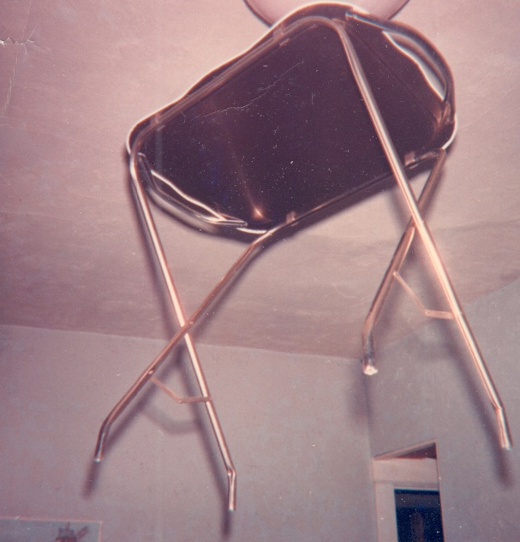
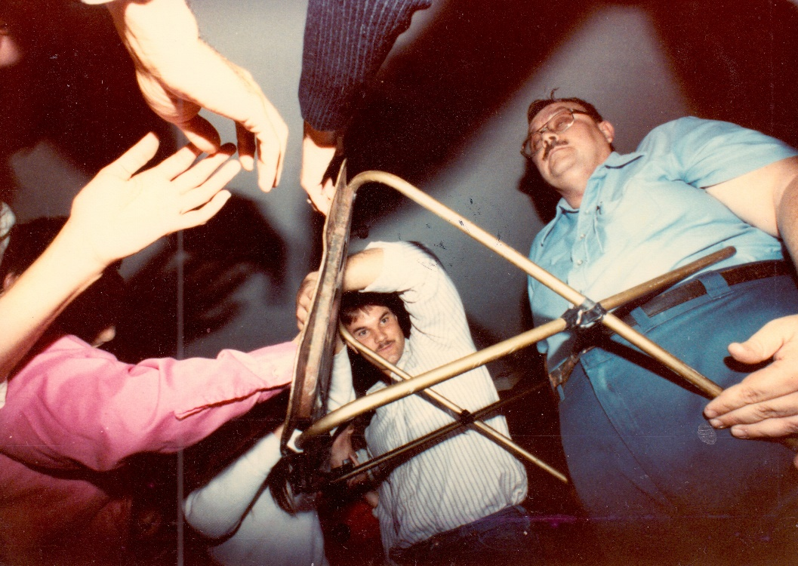
Inside SORRAT: The True Story of America’s Most Active Physical Mediumship Group, 1961-2015
Dr. Jim McClenon

Slide 2
Anomalous Experience Forms: (international surveys)
Apparitions
Paranormal dreams
Waking extrasensory perceptions
Psychokinesis
Out-of-body experience
Near-death experience
Sleep paralysis
Synchronicity
Spiritual healing
These experiences generate beliefs in spirits, souls, life after death, and magical abilities – the basis for shamanism.

Slide 3
Group anomalous experiences:
Hauntings/poltergeists
Pilgrimage sites
Ritual performances:
*Shamanism
*Ouiji board experiences
*Spiritualist groups
*Occult practitioners (fortune tellers, psychics, etc.)

Slide 5
Spiritualist Table Tipping
Spiritualist Movement (1850s-1920s)
Participants sat around a table, placed their hands on it, and eventually experienced rapping sounds and paranormal table movements.
Theory: spirits caused the phenomena

Slide 6
Spiritualist Fraud

Slide 7
Kenneth Batcheldor (1921-1988)
Fear of psi and ownership resistance (fear of being the source) thwart PK.
Artifacts overcome fear.
Exposure to phenomena reduces fear if the person does not feel responsible.
Resulting belief allows authentic PK.

Slide 8
Philip Experiment (1973)
The Toronto Society for Psychical Research devised a fictional entity, Philip. Philip was a mid-1600s, aristocratic Englishman whose wife discovered his love affair with a gypsy girl. The wife accused the girl of witchcraft and the girl was burned at the stake. Philip committed suicide due to remorse,
The group, after focusing on Philip during regular meetings, experienced raps, table-tipping, and poltergeist phenomena.
The rapped messages were limited to Philip’s perspective.
Conclusion: Actual spirits are not required for paranormal phenomena.

Slide 9
John G. Neihardt (1881-1973)
Famous poet and author of the book Black Elk Speaks
Professor of English at the University of Missouri (1949-1965)
Neihardt was familiar with Spiritualism and Native American medicine men.
Founded the Society for Research in Rapport and Telekinesis (SORRAT) in 1961
Goal: to elicit spiritualist phenomena for scientific investigation

Slide 10
Early SORRAT History
1961 – After three months, the group experienced rapping sounds and anomalous table movements.
Phenomena became extremely robust: rapped messages, levitations, poltergeist effects, anomalous lights, earthquake effects.
John Thomas Richards (Tom) was assigned the role of note taker.
SORRAT experienced intense stigma and was reorganized in 1965. Robust phenomena continued.
1967 – Dr. J. B. Rhine suggested sealed box experiments
Early sealed box experiments were successful

Slide 11
John Thomas Richards (1937-2015)
Tom Richards received his Ph. D. in English literature and became a professor
John Neihardt died in 1973.
Richards and other SORRATs continued to conduct experimental sessions.
Richards’ notes describe over 800 sessions in Columbia, Cape Girardeau, Centralia, and Rolla.
The notes indicate that over 300 participants experienced extremely robust phenomena.

Slide 12
Tom and Elaine Richards

Slide 13
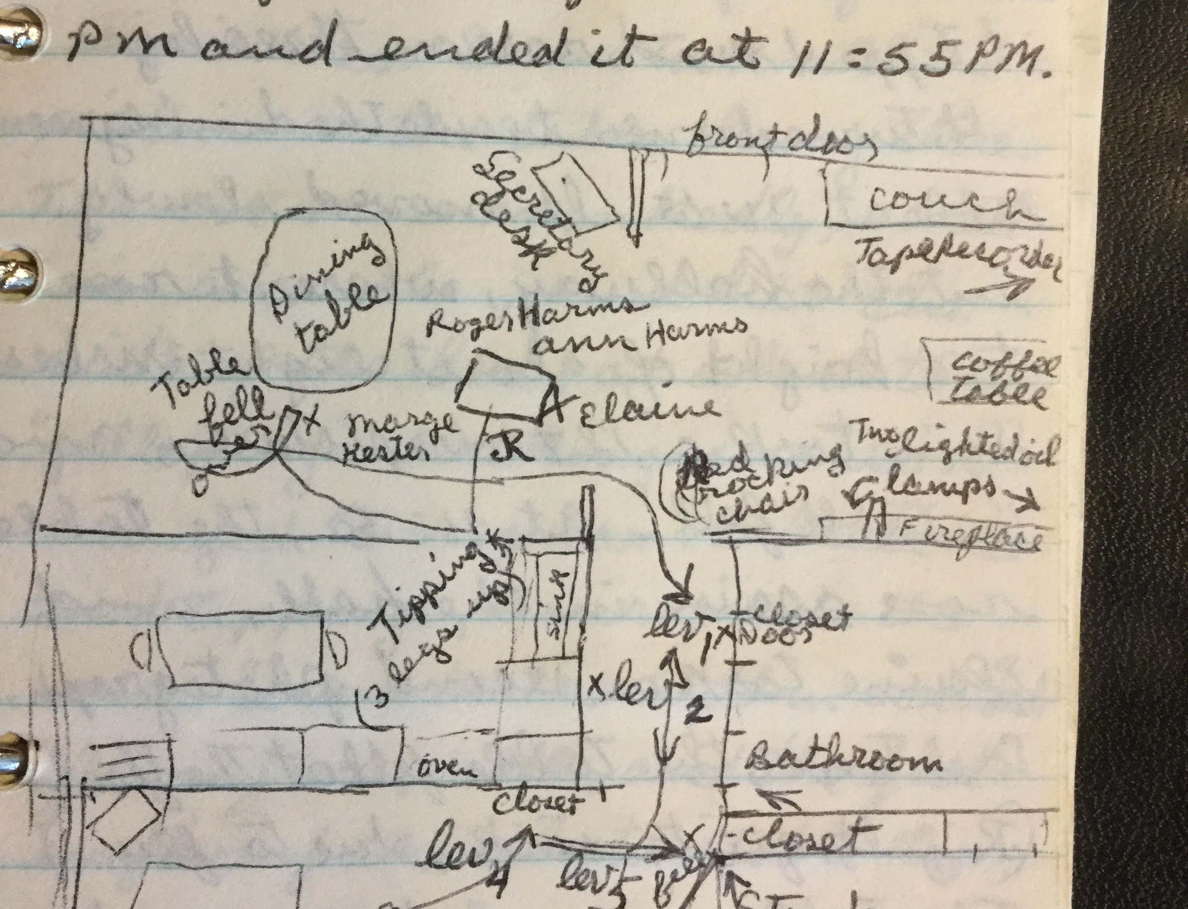
Experiment notes listed:
Experiment objective, location, date, time experiment began, time experiment ended
Names of participants and names of those who went into trance
Phenomena experienced
Positions of witnesses, furniture, flight path of levitating objects
Attempts at photography
Reaction of objects to photographic flash
Reactions of participants (physical/emotional)
Spirit messages
Evaluation of experiment

Slide 15
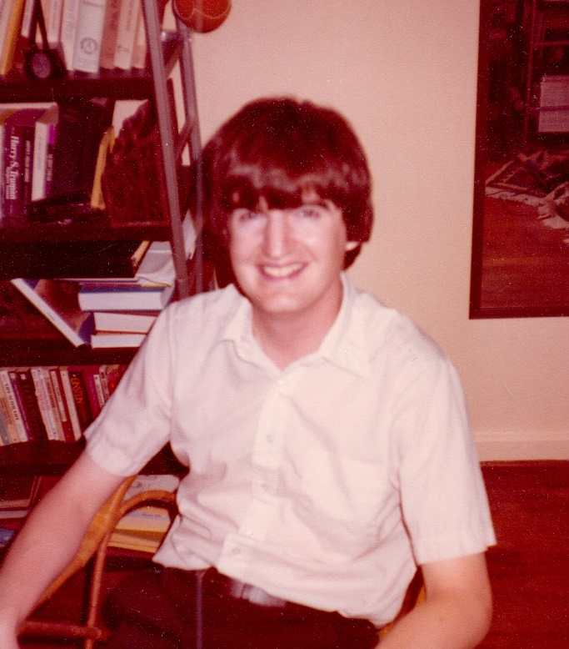
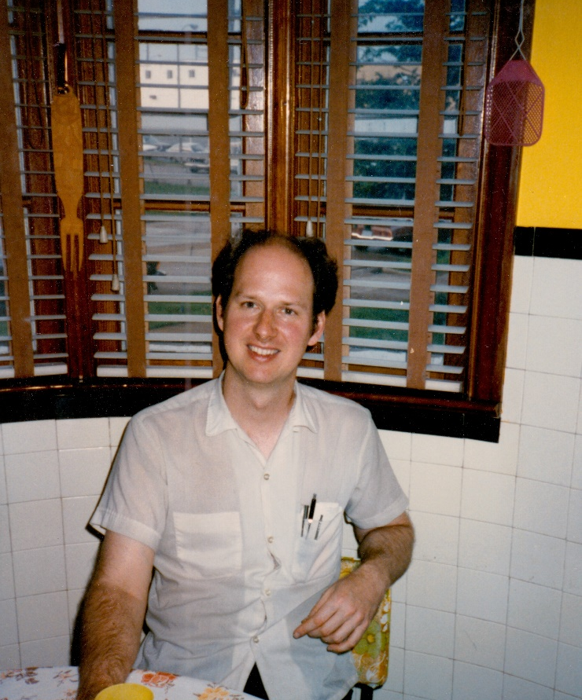
Participants
Tom Richards, Steve Calvin, John Hunt
Richards’ notes indicate that 329 people took part in levitation experiments
36 took part in 12 or more sessions
8 took part in 48 or more sessions (Tom, Elaine, Ivan, Joe, Alice, Ann, Vern, Maria)

Slide 18
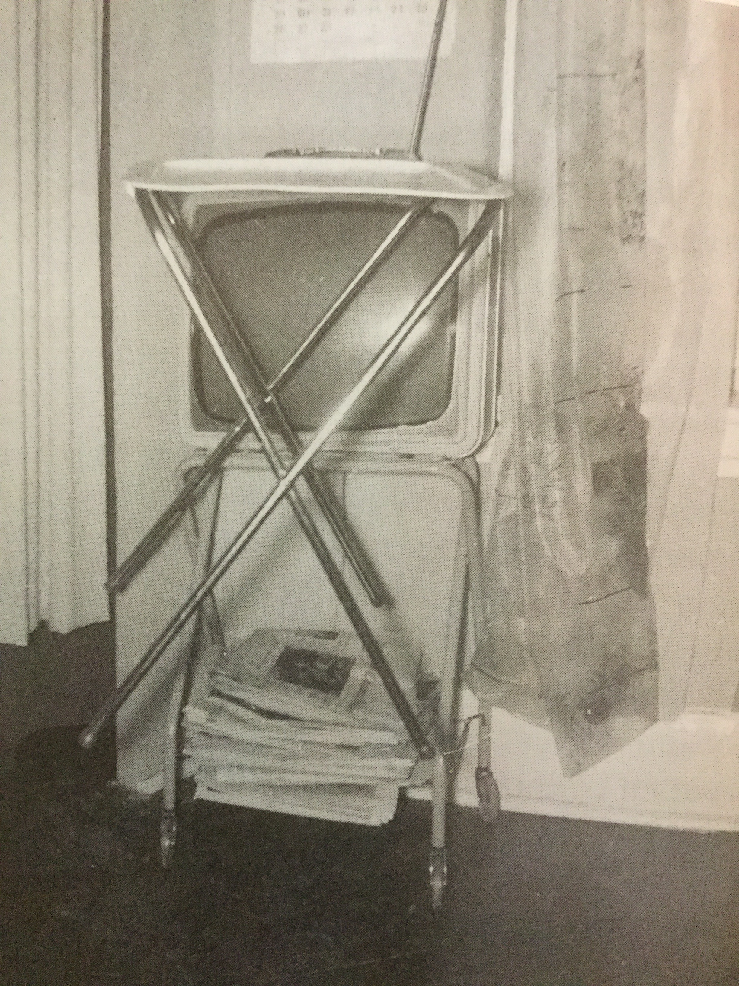

Slide 20
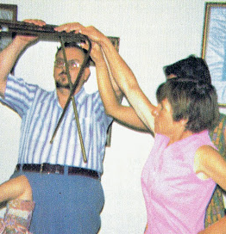

Slide 33
SORRAT VIDEO
Insert Video Here

Slide 36
Sociological Study
1981 – McClenon began his investigation - Visits: 1981, 1982, 1983, 1986, 1988, 1992, 1996, 2001, 2002, 2004, 2017.
1983 – failure to replicate by McDonnell Laboratory for Psychical Research
1983 – Foundation for Research on the Nature of Man (Rhine Research Center) experimental failure
Accusations of fraud
1986 -1996 – Phenomena declined; letter writing continued.

Slide 37
Later Chronology
Although levitation frequency declined, spirit letter writing continued.
1996-2006 - Ivan Richards and his friends participated
1997 – 2001 – many successful levitations, sealed box experiments
2015 – Tom Richards died
2017 – Ivan Richards died

Slide 39
Fish Harp Instructions

Slide 40
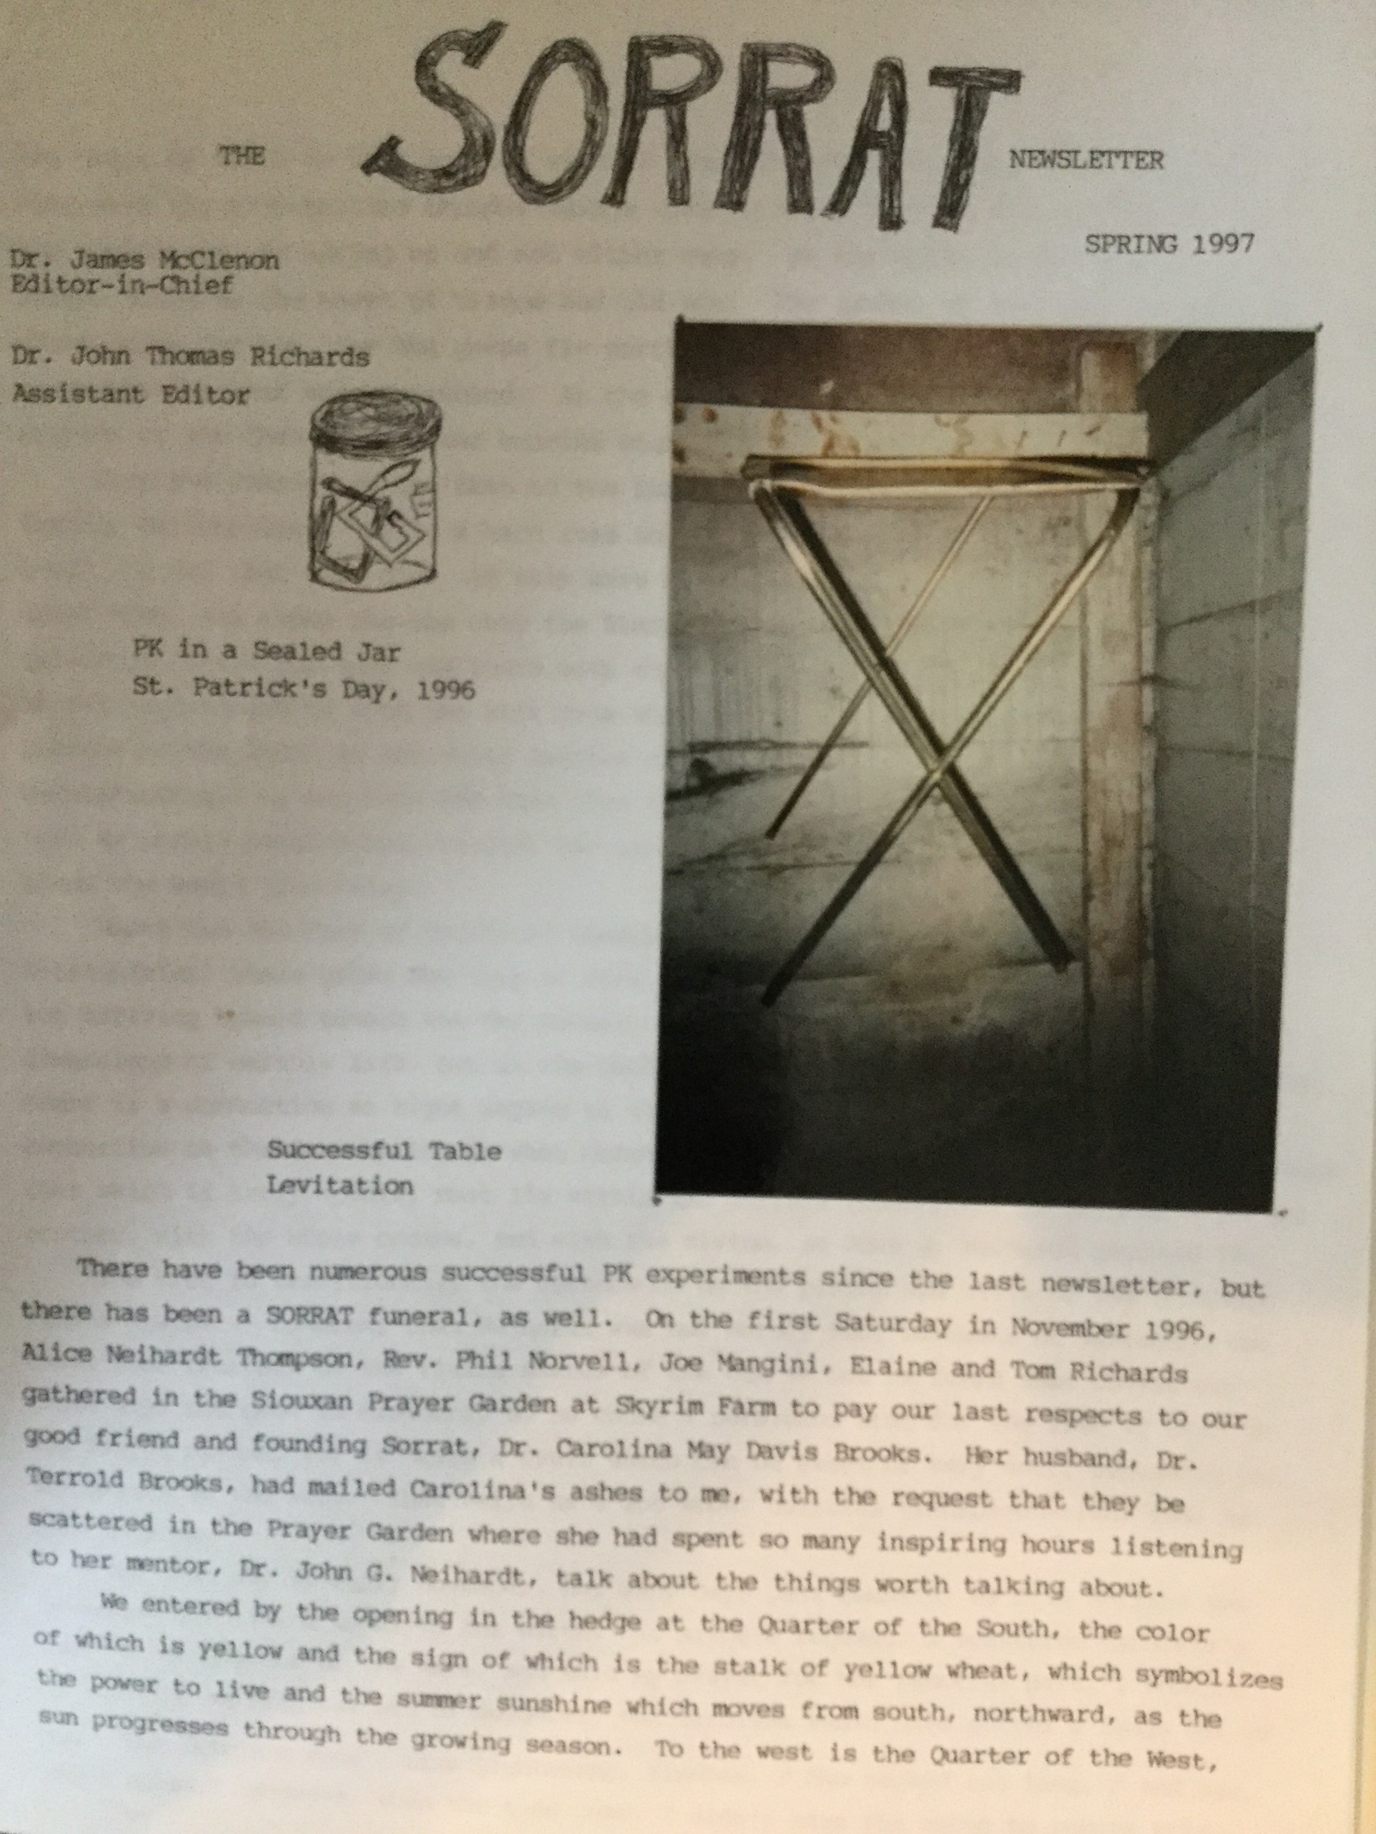

Slide 41
Future Research Project: An Invitation
Research plan: weekly on-line meetings
40-minute sessions
Goal: develop sufficient rapport to experience phenomena

Slide 42
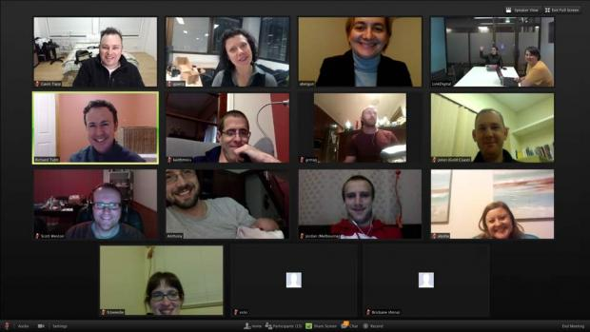

Slide 43
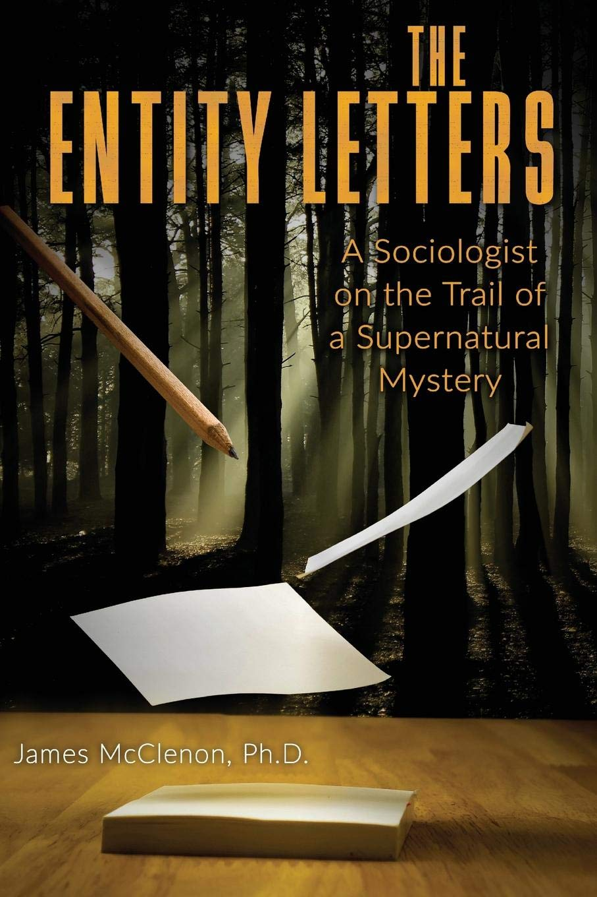
beinghere@gmail.com

