Slide 1
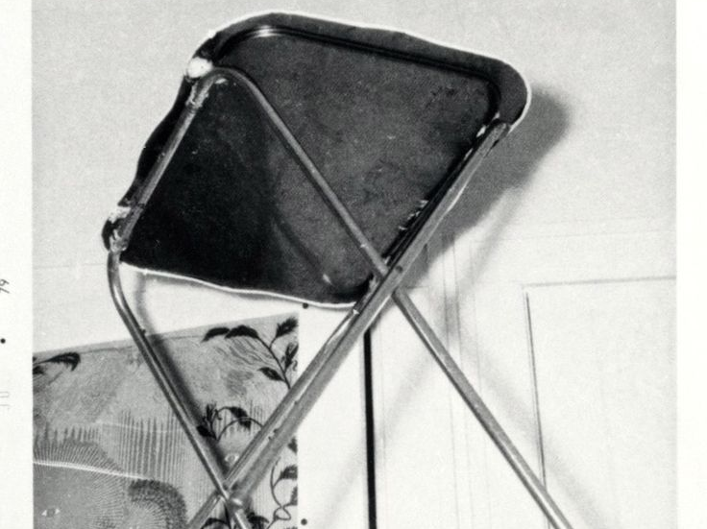
Secondary Analysis of Sitter Group Data: Testing Hypotheses from the PK Literature
Submitted to the Journal of Parapsychology
November 2018
James McClenon, Ph. D.

Slide 2
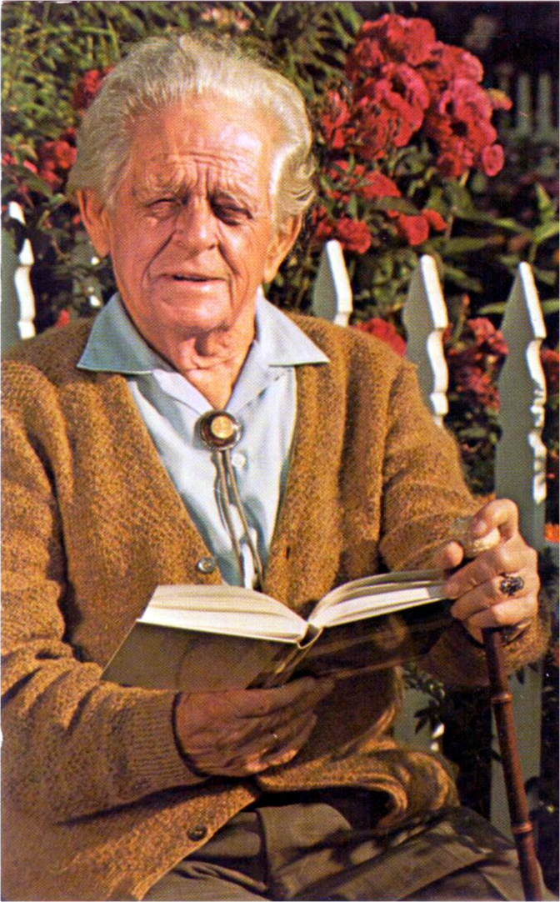
John G. Neihardt
(1981-1973)
Famous poet and author of Black Elk Speaks
Familiar with Lakota Sioux shamanism
Founded Society for Research on Rapport Telekinesis (SORRAT) 1961

Slide 3
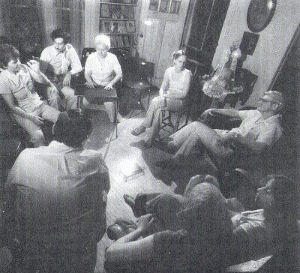
SORRAT participants experienced:
  rapping sounds
  table movements
  levitations
  poltergeist events
  anomalous lights
  earthquake effects
John Thomas Richards, Neihardt’s grad student, took notes
Neihardt advocated skepticism
Neihardt sought advice from J. B. Rhine

Slide 4
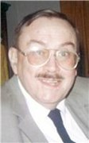
John Thomas Richards
(1937-2015)
J. G. Neighardt died in 1973
Tom Richards became an English professor
He and other SORRATs continued meeting regularly
Phenomena remained robust

Slide 5
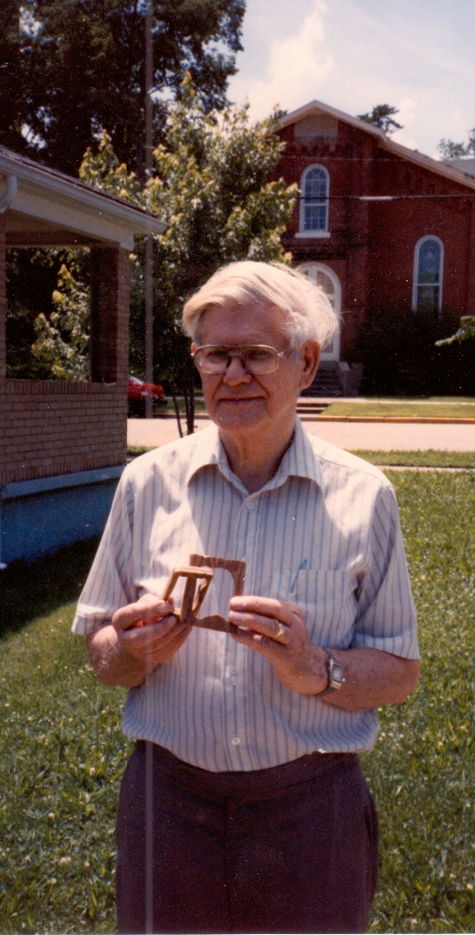
William Edward Cox (1915-1994)
1967: J. B. Rhine suggested sealed box experiments
1969: Rhine sent Ed Cox.
Successful box experiments
1977: Cox moved to Rolla
Cox felt table levitations too uncontrolled
Raps seemed paranormal; began investigation

Slide 6
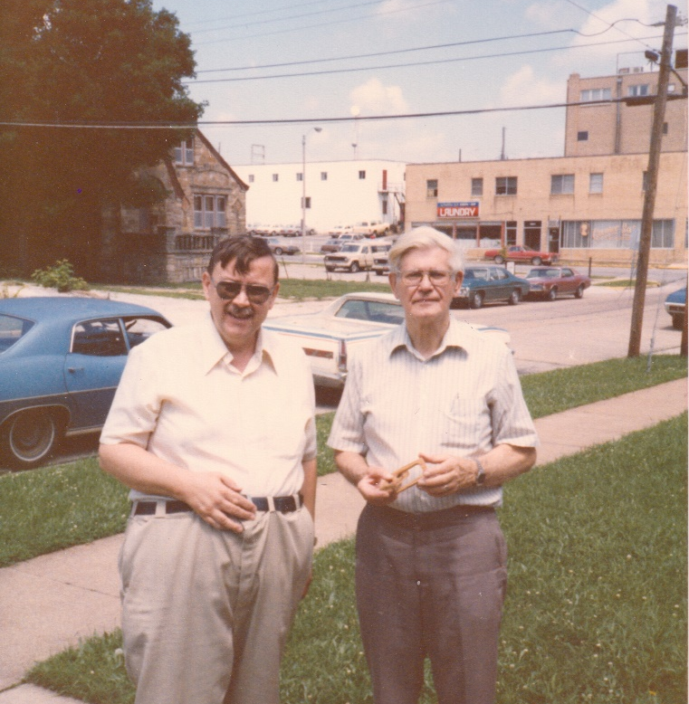
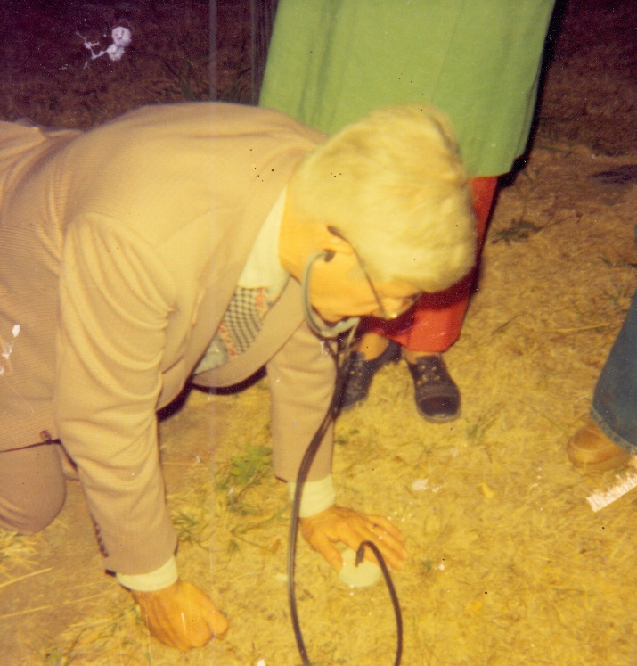
Rap investigation
Raps spelled out messages from spirits, emanating from:
  wood or concrete floors
  walls
  bare earth
  in private homes and public places
Raps did not com from Richard’s body, but often from a point close to his feet.
Cox was unable to detect use of mechanical devices.
Raps revealed hidden numbers but did not consistently demonstrate ESP

Slide 7
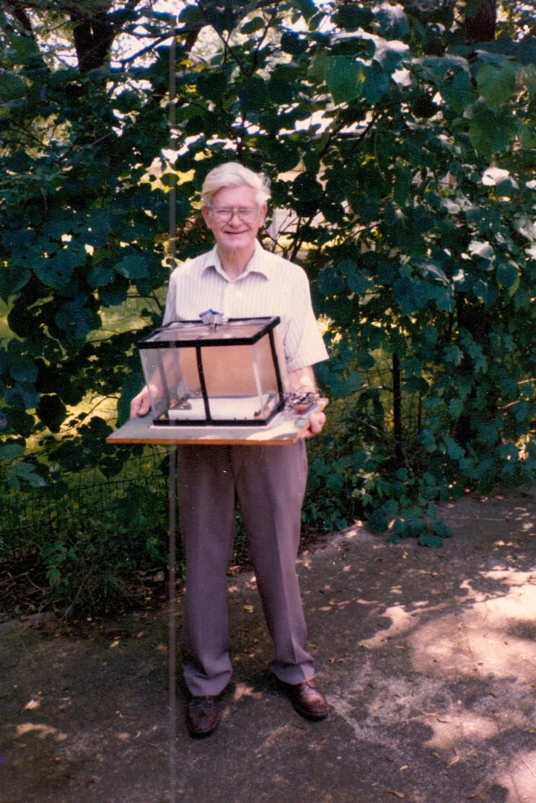
Minilab Experiments
1978: Cox built sealed containers (minilabs) with micro-switches
1980-1983: films of ostensible PK generated intense skepticism
No true discussion of Cox’s efforts.

Slide 8
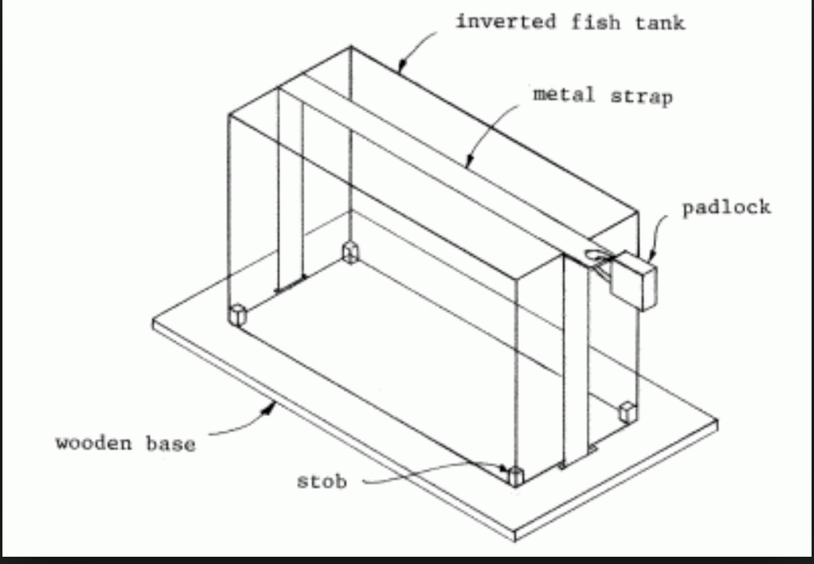
Cox’s Minilab

Slide 9
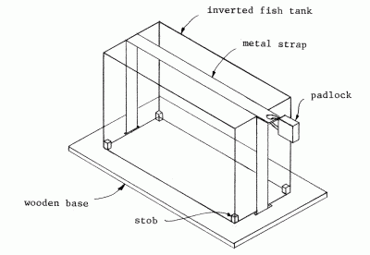
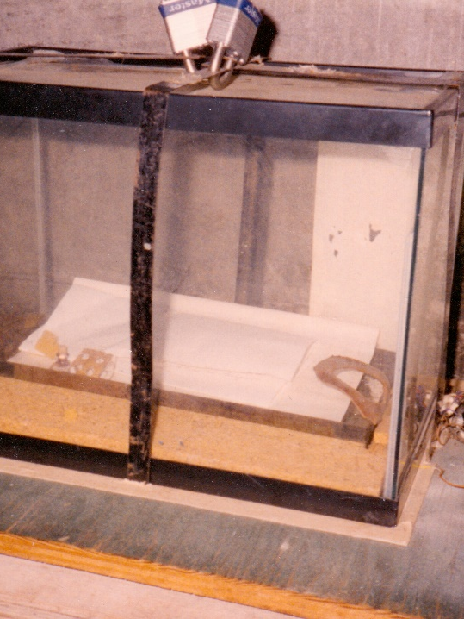
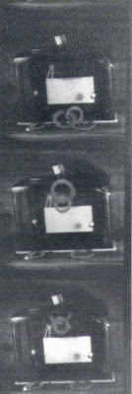
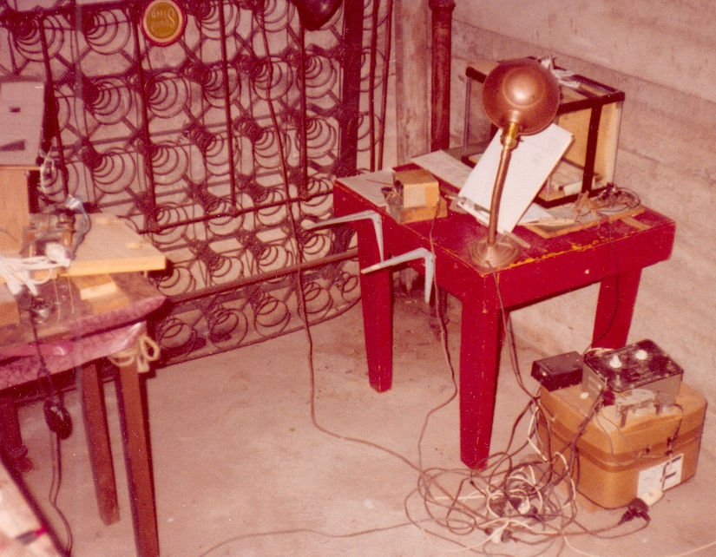
Cox’s Mini-lab

Slide 10
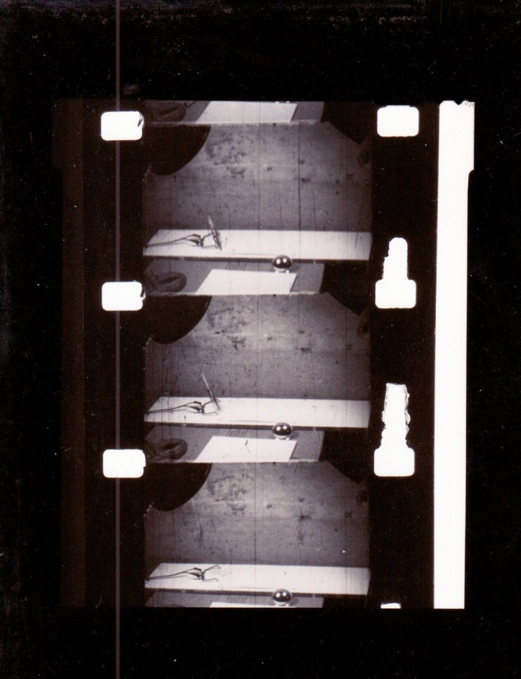
Mini-lab films

Slide 11
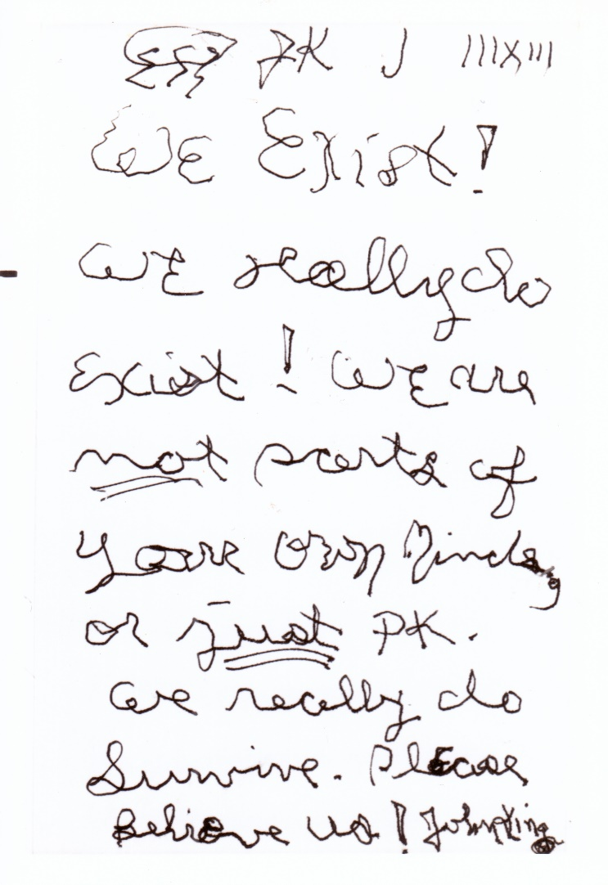
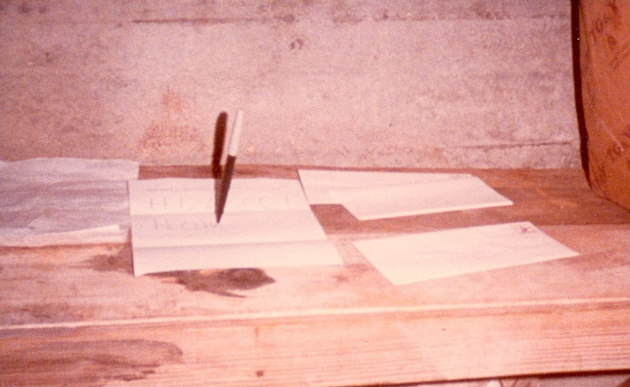
Entity Letters

Slide 12
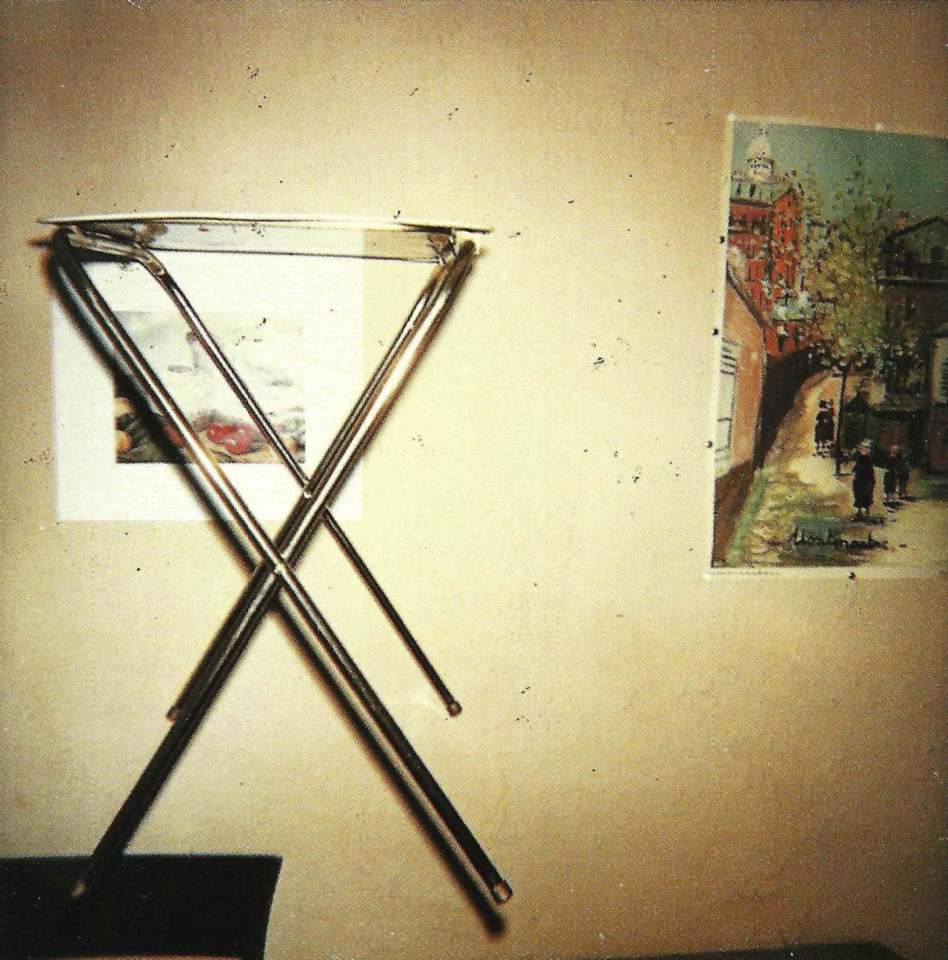
SORRAT History
1961 – 1966 Dr J. G. Neihardt organizes SORRAT
1962-1965 Tom Richards in Arizona (1962-1965)
1965 Richards returns to Columbia; Neihardt asks him to help re-organize SORRAT group
1966-72 – Tom Richards in Columbia, then moves to Cape Gardeau, Missouri where he teaches college classes
1974-1977 Richards lives in Columbia, then Centralia
1977 Richards moves to Rolla, Missori (1977), Cox retires, movers to Rolla (1977)
1978 Cox constructs early minilab
1979-1982 – Cox mini-lab films
1981 McClenon begins sociological investigation
1983 – Replication failures (FRNM, McDonnell Laboratory for Psychical Research)
1999-2007 Ivan Richards (Tom‘s son) plays important role in SORRAT

Slide 13

McClenon - Participant Observation (1981-2017)
Began sociological investigation of SORRAT in 1981
FRNM experiment failed
McDonnell Lab unable to replicate Cox’s minilab experiments
Visits in 1981, 1982, 1983, 1986, 1988, 1992, 1996, 2001, 2002, 2004, 2017 (retrieved notes)
Richards documented experimental sessions until his death in 2015

Slide 14

Theory:
Spirits do it
No replicable experimental strategy

Slide 15
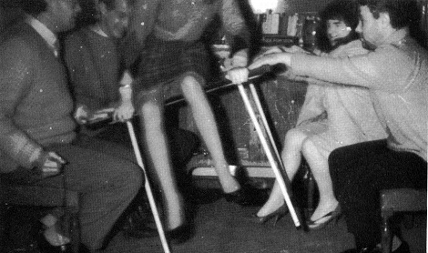
Kenneth Batcheldor (1966, 1979, 1984)
Fear of psi and ownership resistance thwart PK
Artifacts overcome these obstacles
Resulting belief allows authentic PK
Later revision: Universal Creative Principle

Slide 16
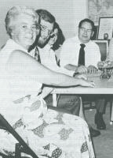
Conjuring Up Philip
(Owen and Sparrow, 1972)
The Philip Group (1972-1977)
Batcheldor’s suggestions brought success
Raps, table movements
Assumption: collective ideology facilitated PK

Slide 17
SORRAT
John G. Niehardt hypothesized that rapport facilitated PK
ideas shaped by Black Elk and “pragmatic mysticism”
SORRAT experiment preceded Batcheldor/ Philip Group but Richards corresponded with Batcheldor

Slide 18

Ritual Healing Theory
Ancient hominids:
  huddled around fires for many millennia
  developed voice modulation (singing, dancing), symbolization, language, ritual
  derived hypnotic/placebo benefits from ritual healing
  absorption/ dissociation genes became more prevalent
Process shaped anomalous experiences:
  apparitions
  paranormal dreams
  waking ESP
  PK
  OBE
  NDE
  synchronicity
  spiritual healing
  UFOs

Slide 19
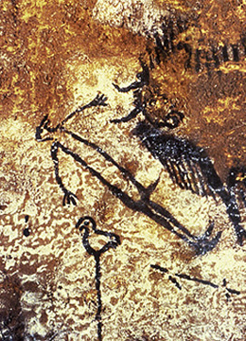
Ritual Healing Theory
Result: beliefs in spirits, souls, life after death, and magical abilities -- the foundations for shamanism
Shamanism’s evolutionary impact shaped spirituality
This theory emphasizes the role of special individuals (shamans) and small groups

Slide 20
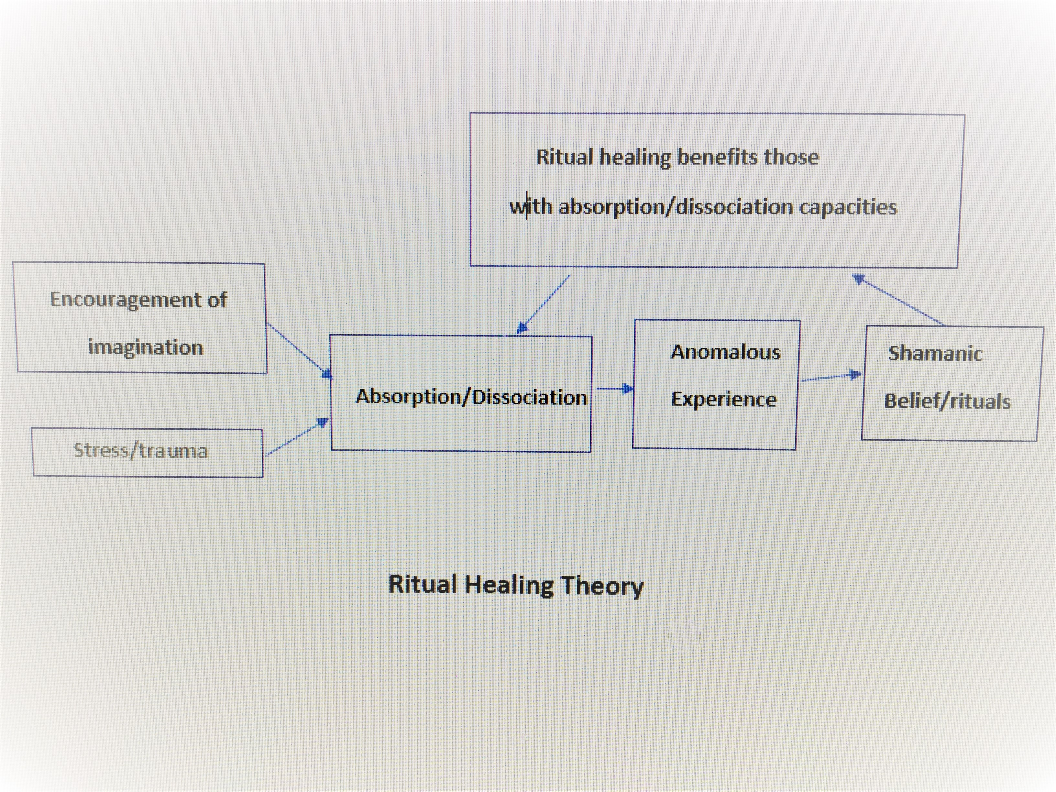
Ritual Healing Theory

Slide 22
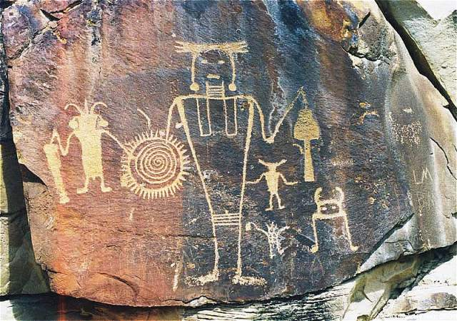

Slide 23
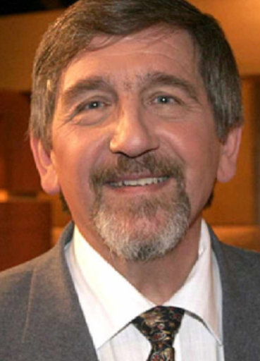
Walter von Lucadou
Model of Pragmatic Information
Psi - a product of quantum mechanic entanglement
Entanglement occurs when particles created together
Particles remain correlated even though separated
Allows “spooky action at a distance” – such as ESP, PK
Zeno effect - continuous observation prevents quantum decay
Theory explains psi’s “hiding quality”

Slide 24

Theory:
The Role of Consciousness
Anomalous experiences are correlated – implying consciousness as a underlying basis
Ganzfeld theory and Asian religious traditions regard normal consciousness as an obstacle to psi
Hindu/Buddhist/quantum theories imply a reality/consciousness connection
Theory: Conscious states of special people/groups disrupt collective consciousness, allowing alternate collective consciousness.

Slide 25
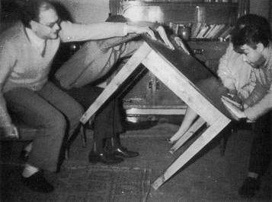
Common Theoretical Elements
People with certain characteristics thwart PK
Group interaction can overcome this resistance

Slide 26
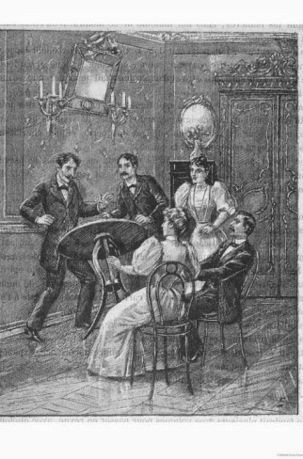
Two Basic Theories
Facilitation/suppression theory – Most people suppress PK; some facilitate it
Interaction theory: Group participation (exposure to artifact, fraud, focus on narrative, rapport, shamanism) facilitates PK

Slide 27
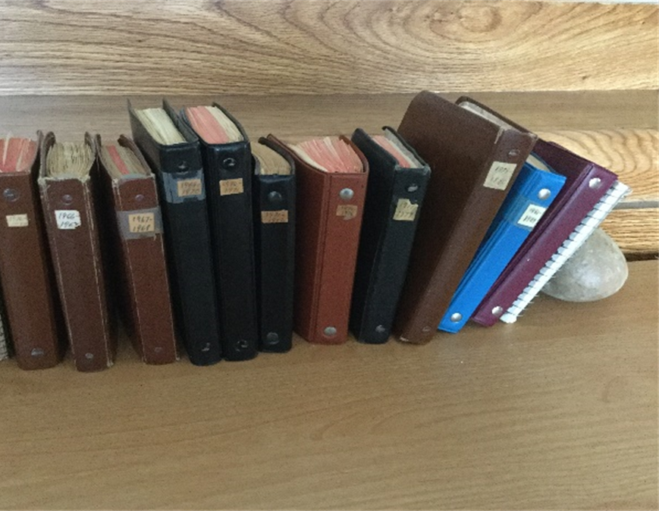
Methodology
Participant observation included visits with SORRATs in 1981, 1982, 1983, 1986, 1988, 1992, 1996, 2001, 2002, 2004, 2017
Weekly correspondence with Tom Richards (1981-2004)
Analysis of 14 experimental record notebooks.

Slide 28
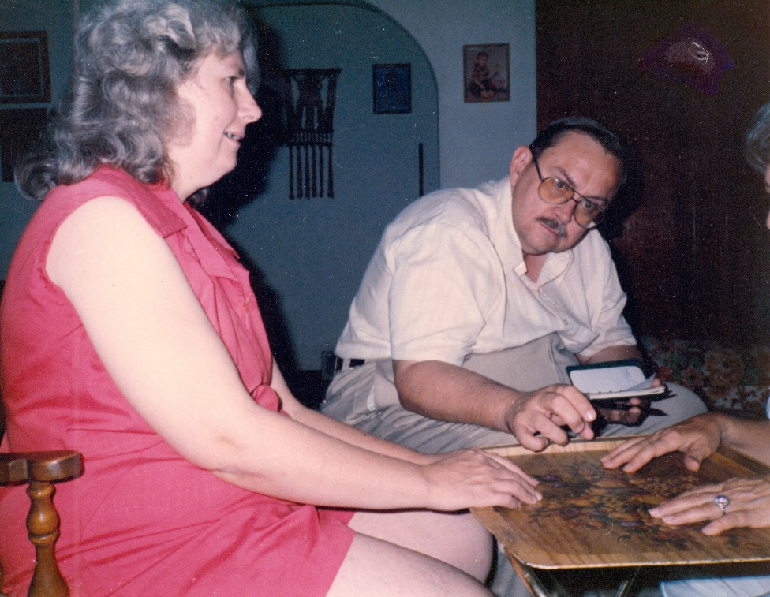

Slide 29
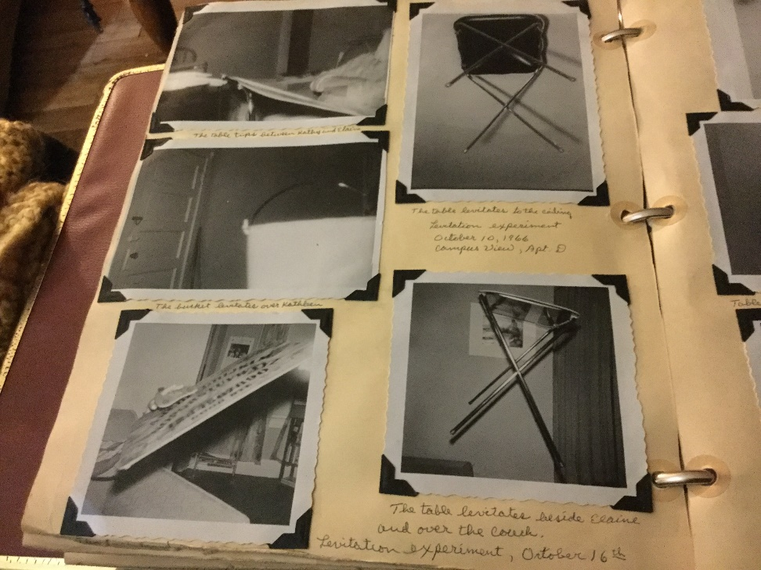
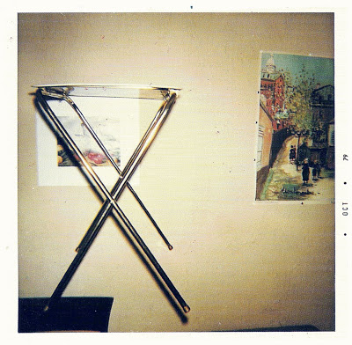
SORRAT Photo Albums

Slide 30
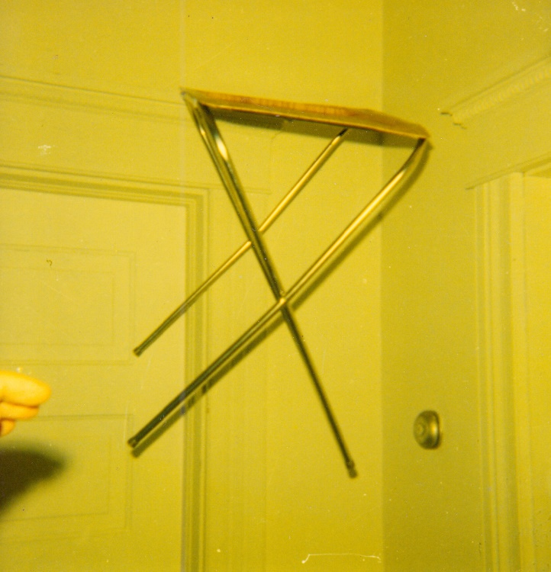
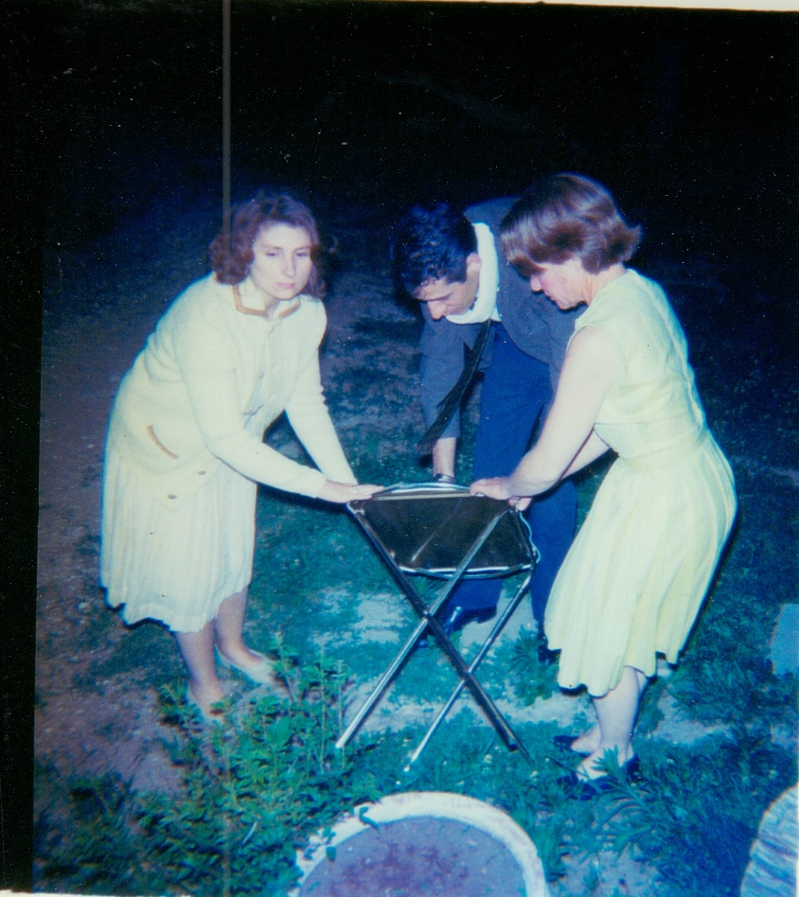
Participant Photographs

Slide 31
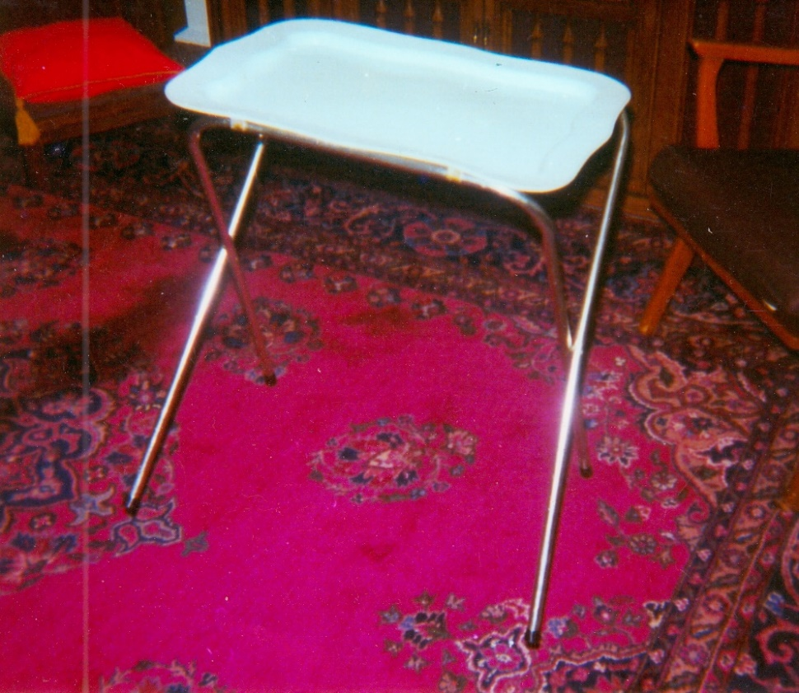
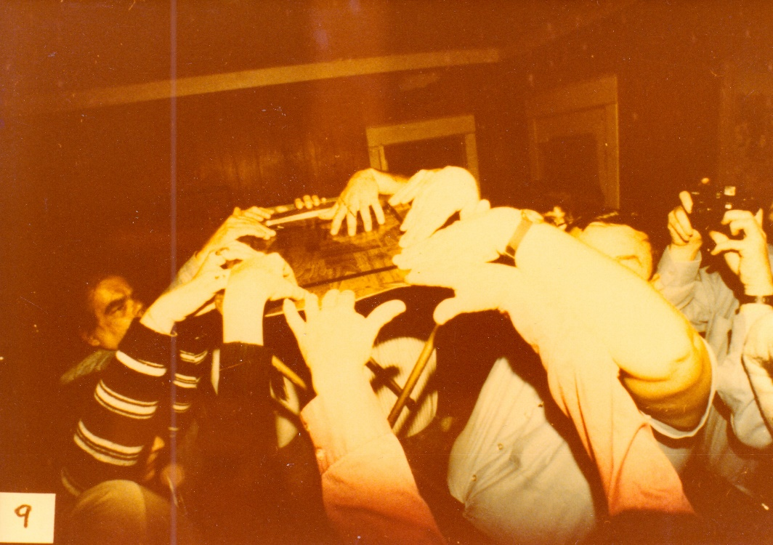
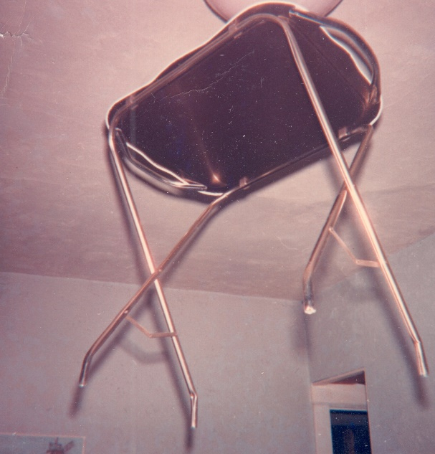

Slide 32
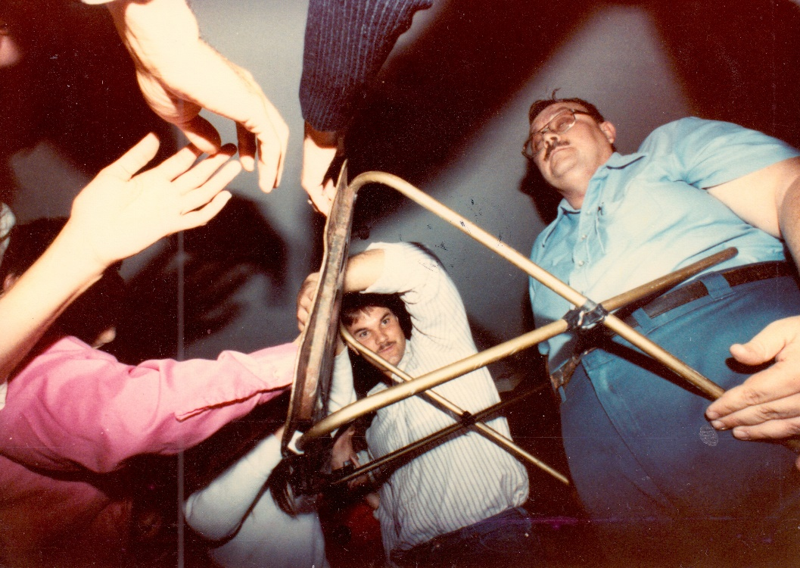

Slide 33
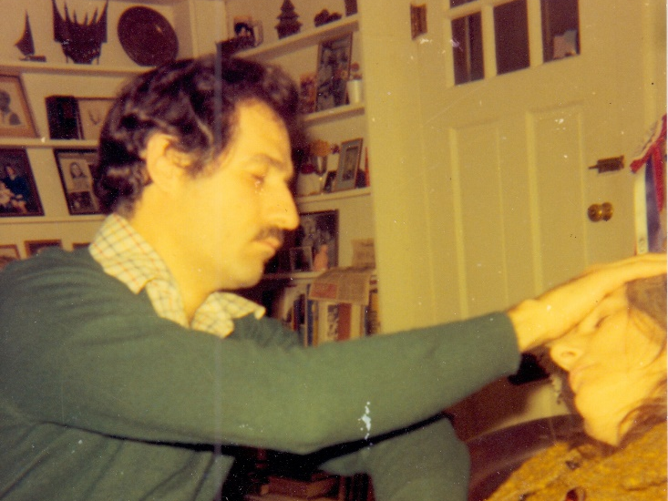
Spiritual Healing
Placebo and hypnotic effects

Slide 34
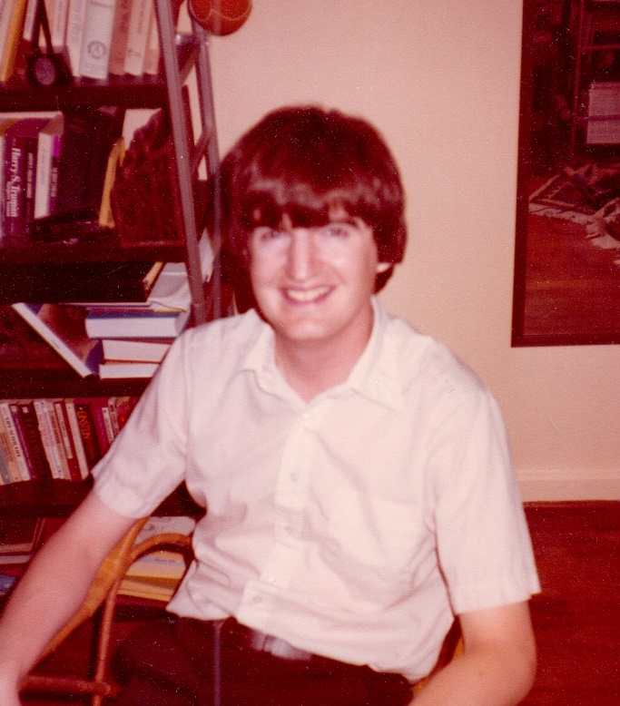
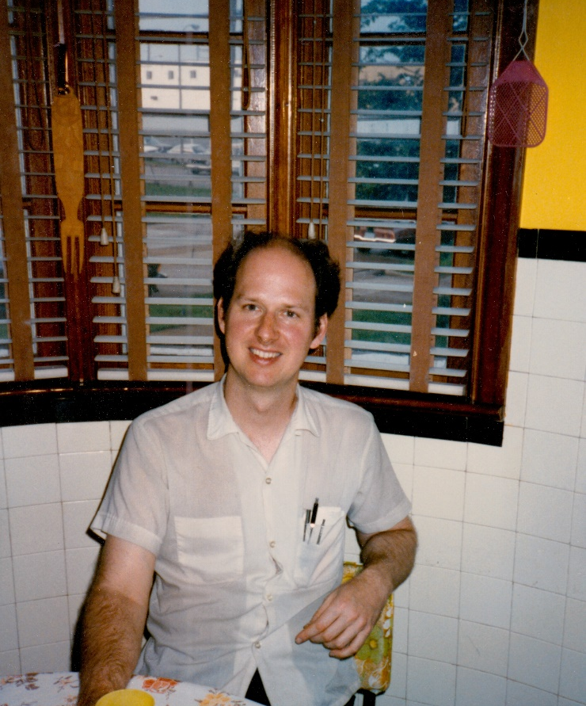
Participants
Tom Richards, Steve Calvin, John Hunt
329 people took part in levitation experiments
36 took part in 12 or more sessions
8 took part in 48 or more sessions

Slide 35
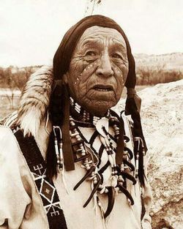
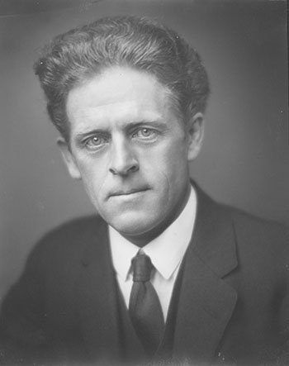
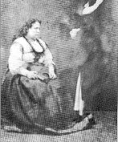
SPIRITS
Black Elk
John G. Neihardt
John King
Patience Worth
many others: relatives of SORRAT members

Slide 36

Methodological dilemmas
Phenomena:
avoided verification
not consistent
absurd, silly
engaged in fraud
generated severe stigma
difficult to quantify

Slide 37
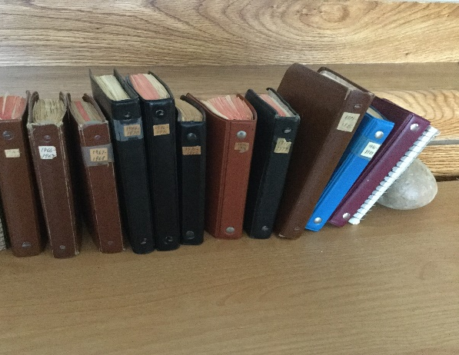
Experimental Records
2015: Tom Richards died
2017: located 14 notebooks describing about 850 experiments
(1966-1972, 1974-1984, and 1999-2007 – missing data)
729 sessions had the goal of levitation

Slide 38
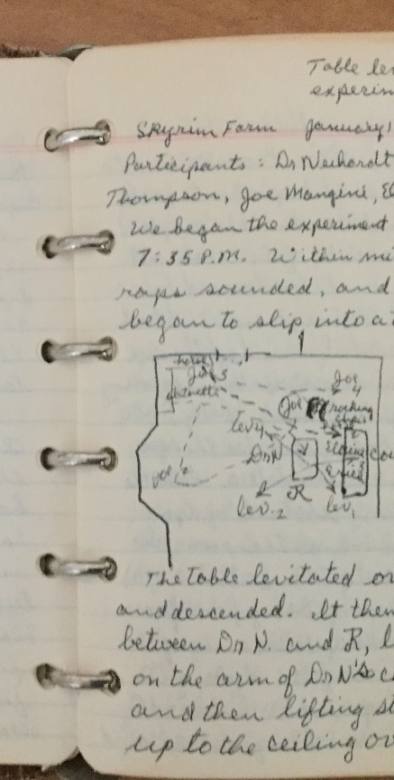
Experimental Records
Each experimental record provides:
(1) experiment objective, location, date, time experiment began, time experiment ended
(2) Names of all participants
(3) Phenomena experienced
(4) Diagrams with positions of witnesses, furniture, flight path of levitating objects

Slide 39
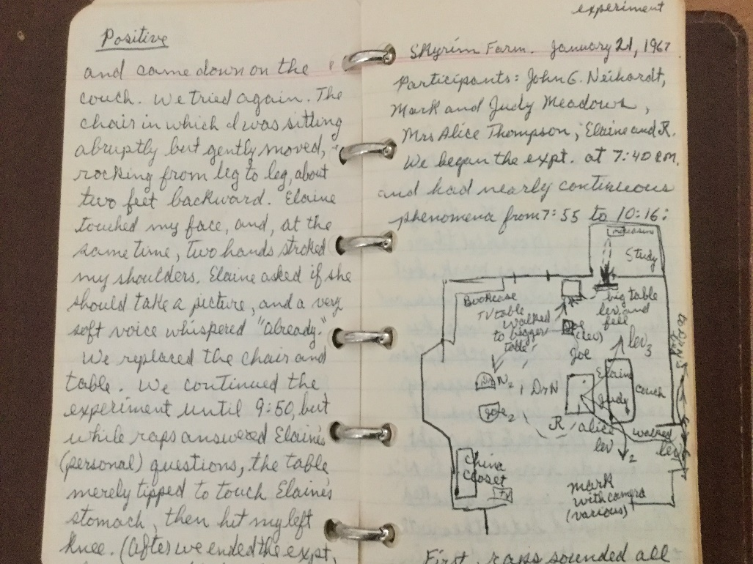
Experimental Records
(5) Attempts at photography
(6) Reaction of object to photographic flash
(7) Reactions of participants (physical/emotional)
(8) Names of participants in trance
(9) Documentation of spirit messages
(10) Evaluation of experimental success (success, partial success, failure)

Slide 40
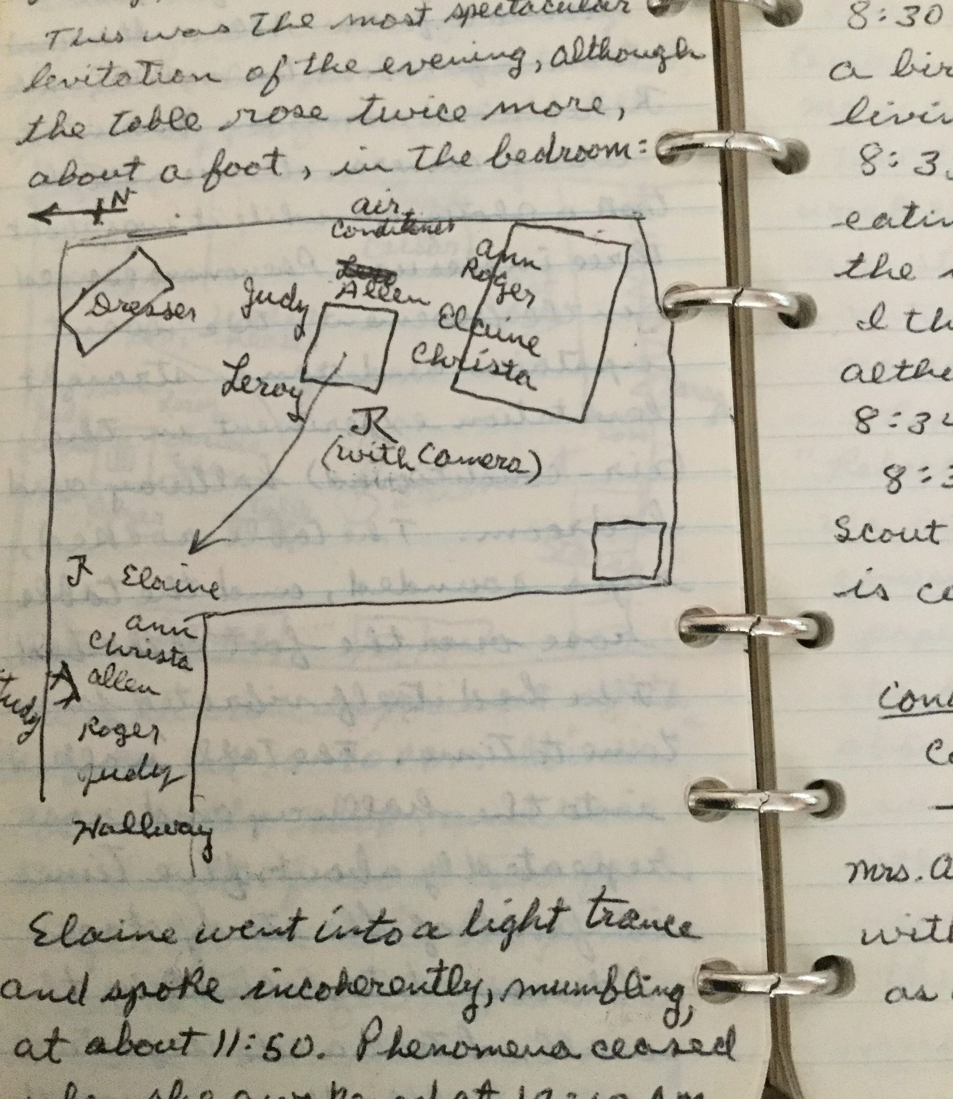
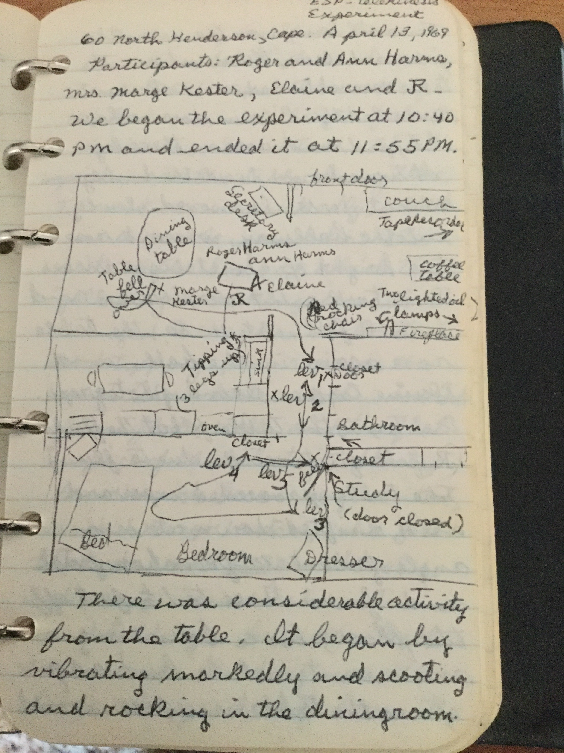
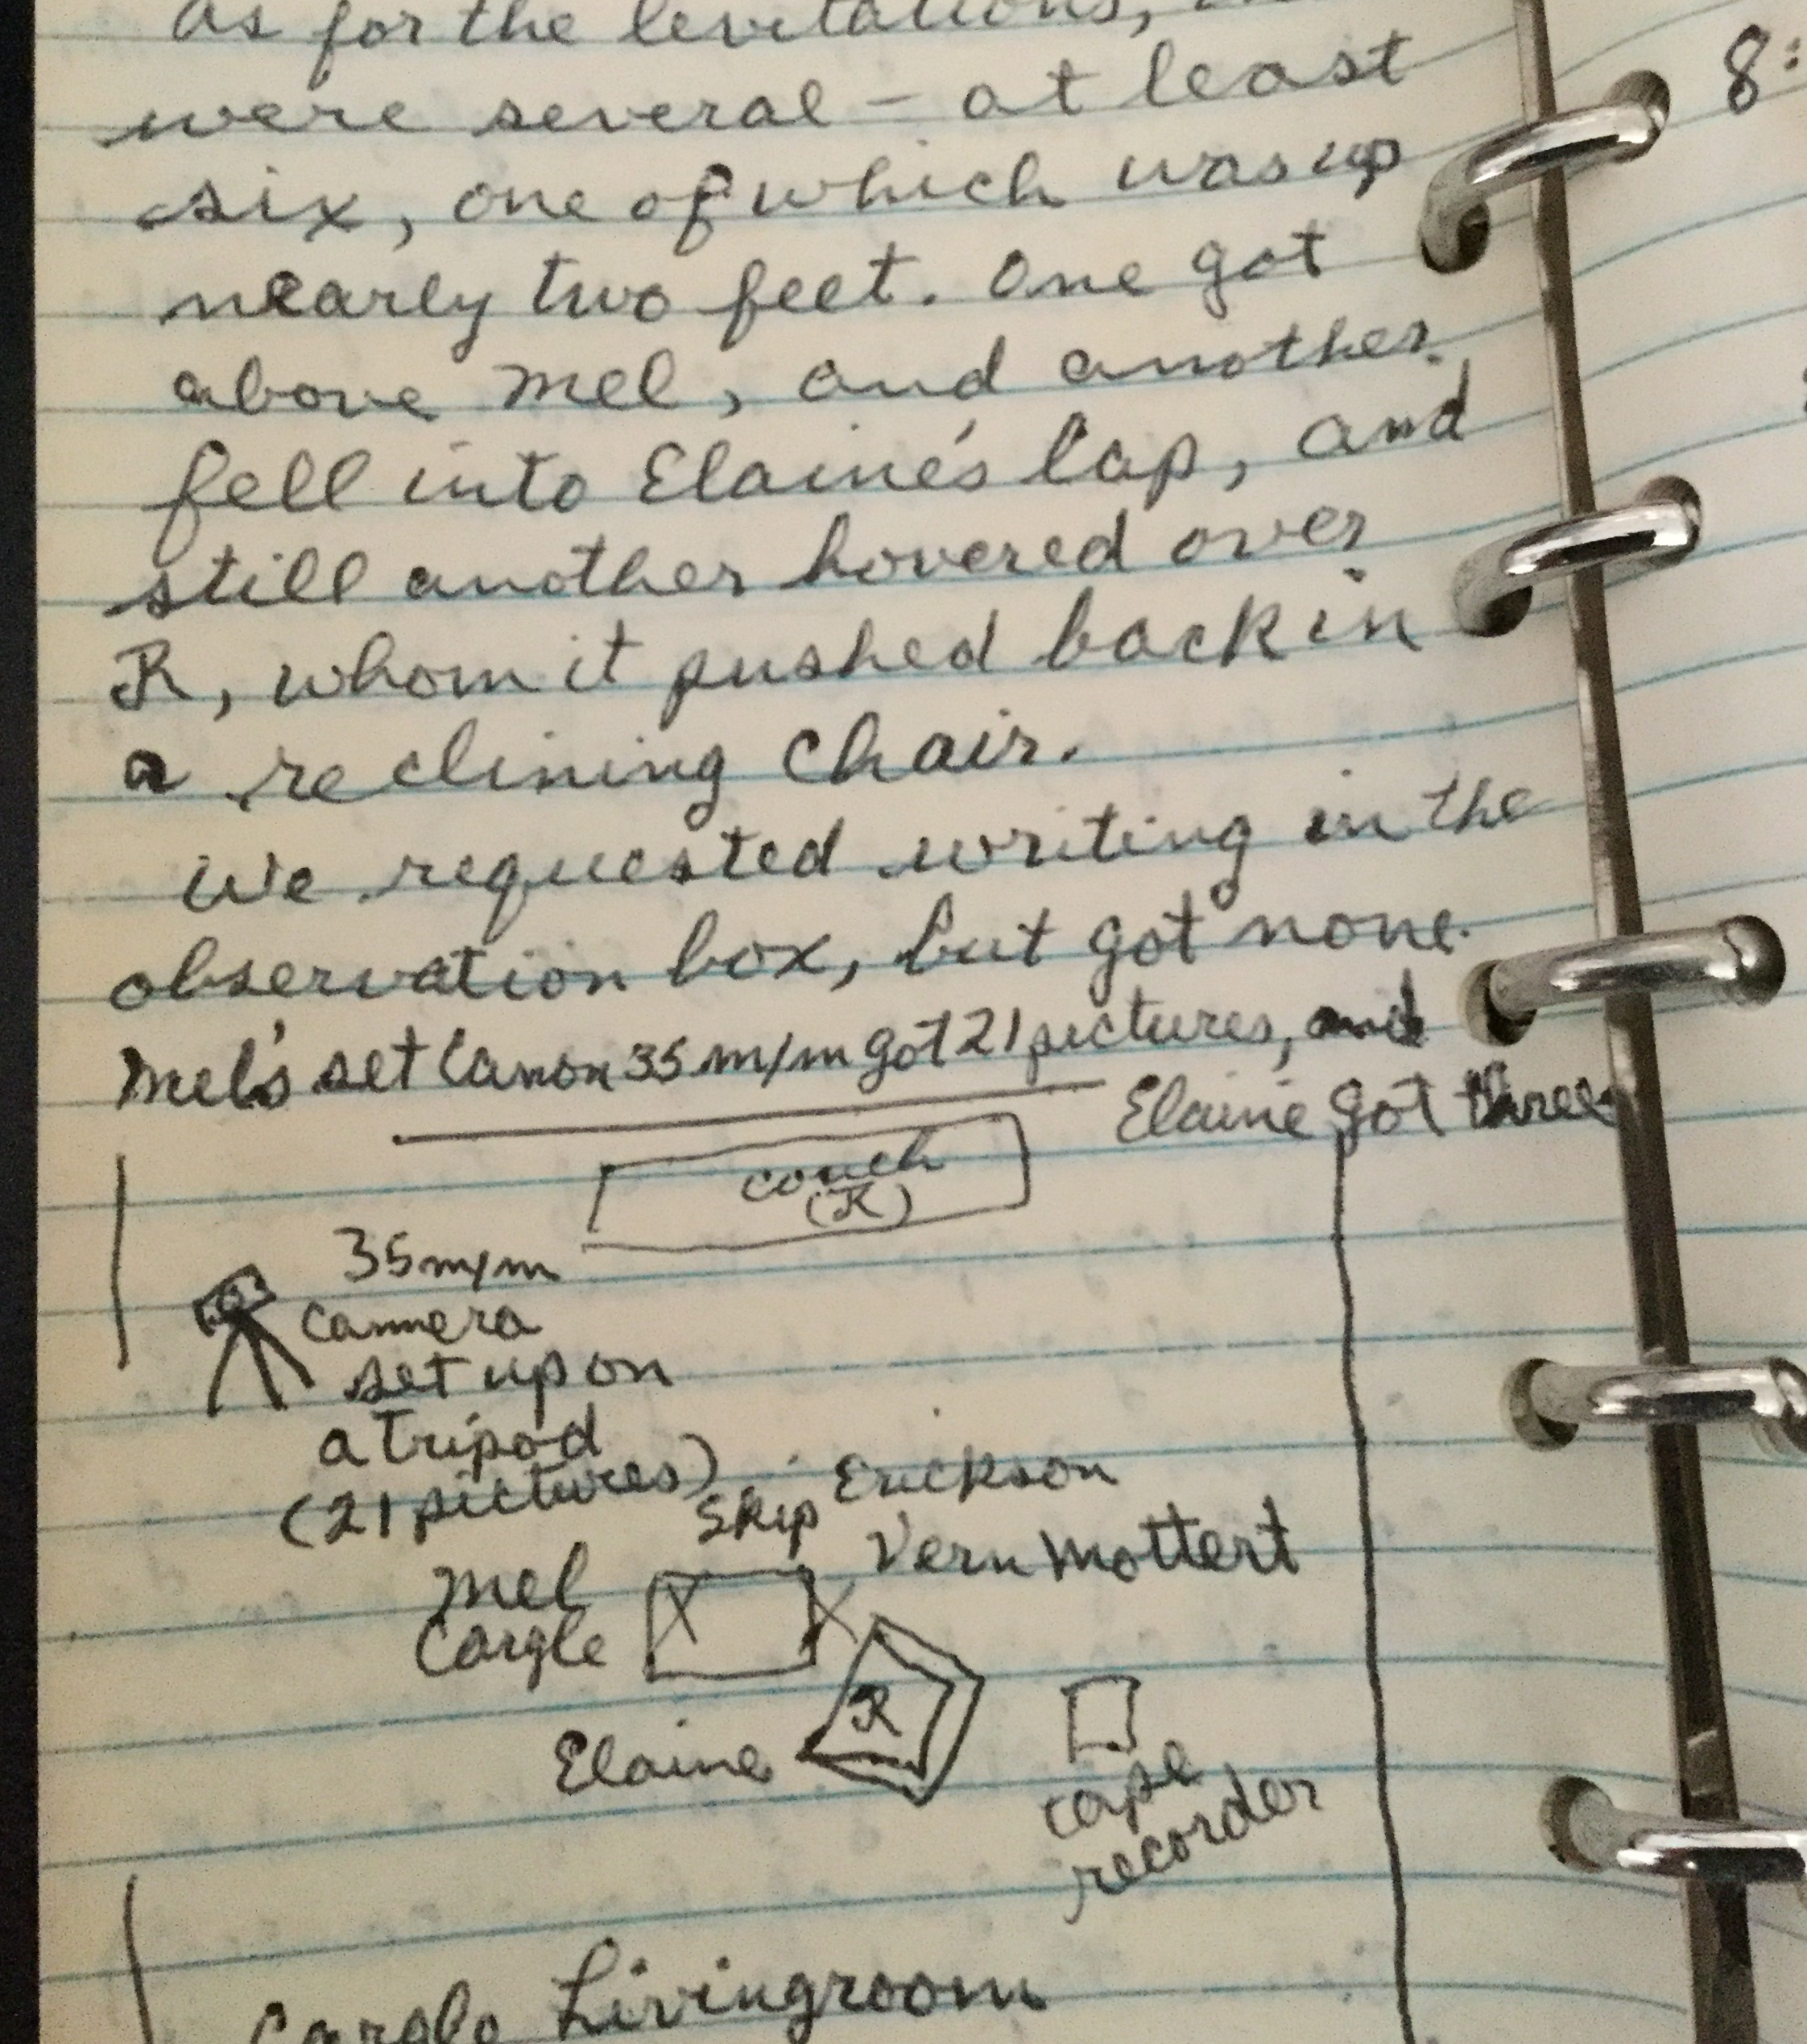
Notes show:
flight path of objects
Position of observers
Position of cameras
Position of tape recorder
Furniture

Slide 41
Evaluation of levitation success
Evaluations of levitation success were based on:
Height of the levitation
Degree that participants removed their hands
Time object remained in the air
Was object photographed during levitation?
Methodological problems: (1)Richards’ notes do not fully document lighting during the experiment (2) Richards sometimes spontaneously went into trance

Slide 42
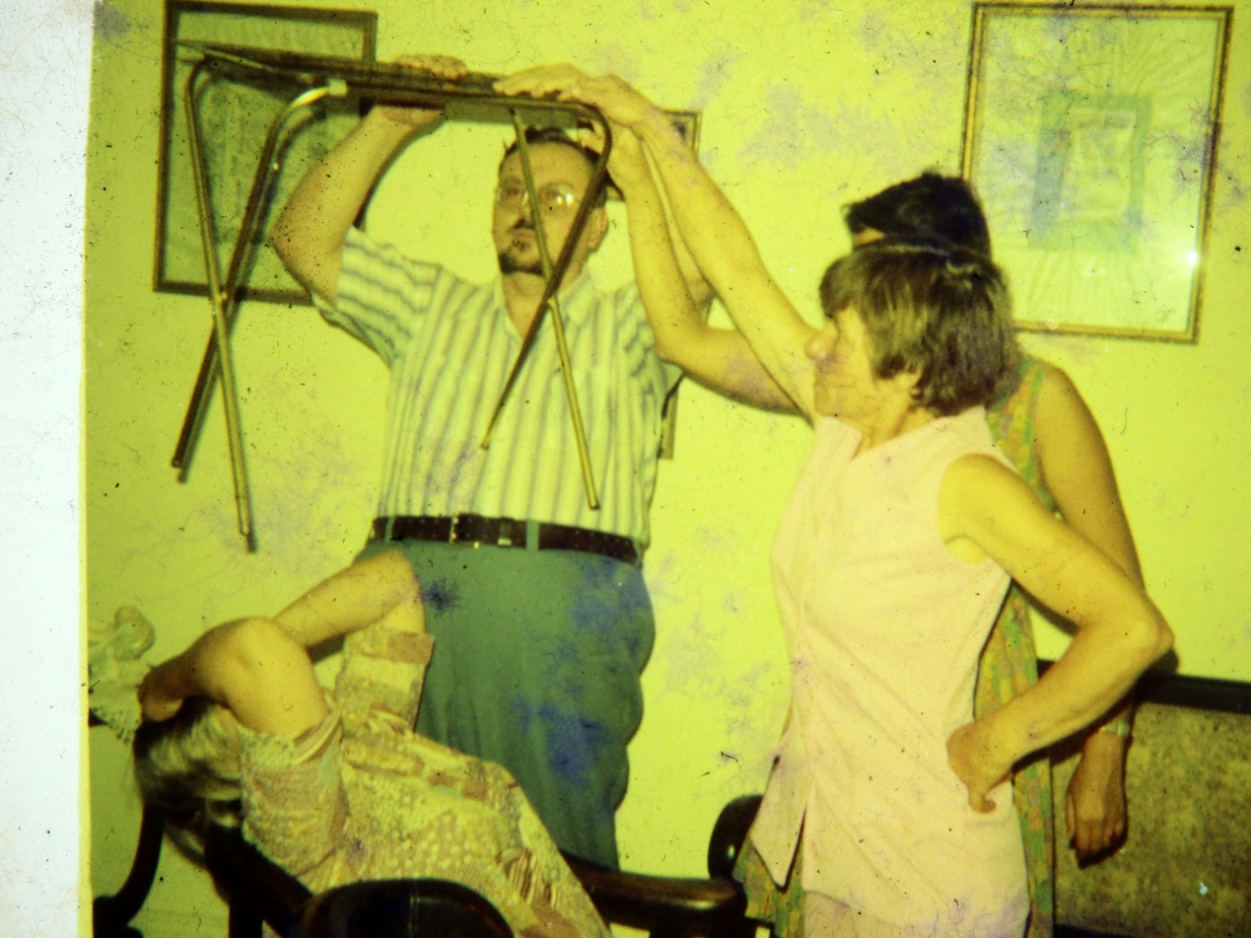
Formal Hypotheses
Hypothesis 1 (Facilitation/suppression theory): Size of experimental group should vary inversely with levitation success.
Since the average person suppresses PK, larger groups should have greater PK suppression.
NOTE: multilevel analysis problems for chi square – will use Pearsons Product Correlation
Hypothesis 2A and 2B (Facilitation/ suppression theory): Individual levitation experiences should not be distributed normally but be skewed, since a smaller percentage of people facilitate PK.
Hypothesis 3 (Interaction theory): People attending many group PK sessions should have higher levitation success rates than those attending fewer sessions since participation leads to success.

Slide 43
Exploratory Hypotheses
Relationship with levitation success:
Location
Time period
Combinations of participants
First or second half of the individual’s time of participation (second half should show increased success)

Slide 44

Coding of Variables
date
location
names of those participating
number of participants
experimental objective: levitation, sealed box experiment, poltergeist effects, other
attempt to photograph levitation object (yes/no)
names of participants in trance
levitation success (success, partial success, failure)

Slide 45
Time-Period and Levitation Outcome
Period Failure Partial Success
Success
1966-1972 31.6% 17.5% 50.9%
1974-1977 40.0% 19.1% 44.9%
1977-1984 58.6% 13.1% 28.3%
1999-2007 27.4% 10.5% 62.0%
Totals 34.3% 14.5% 51.2%
Chi-square = 44.2; df=6; p < 0.00001
Levitation Outcome varied over the various time-periods

Slide 46
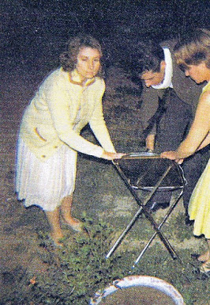
Location and Levitation Outcome
Location Success Rate
Skyrim 49.1%
Columbia 45.1%
Cape Girardeau 53.2%
Centralia 50.0%
Rolla (Tom) 56.5%
Rolla (Harold) 23.5%
Other 43.4%
Chi square = 27.1
df = 12
p = .0076

Slide 47
Hypothesis 1:
Group Size and Levitation Success
Number Failure Partial Success
In group Success
24.2% 19.0% 56.9%
31.5% 12.2% 56.3%
42.4% 13.1% 44.4%
40.9% 12.1% 47.0%
34.9% 21.9% 50.8%
34.1% 21.9% 44.9%
24.1% 24.1% 51.7%
61.1% 5.5% 33.3%
10-11 35.3% 17.6% 47.1%
12-25 75.0% 0.0% 25.0%
Chi square = 39.8, df=18, p = .002*
Pearson product correlation: R = - .115 (N=729, p = .0009, one tail)
This finding supports the facilitation/ suppression theory
*Note: p value provided for information purposes only (chi sq. assumptions violated due to layered data)

Slide 48
Hypothesis 2:
Individual Levitation Outcomes
SORRAT Failure Partial Success
Member Success
Tom Richards 33.3% 14.5% 52.1%
Elaine Richards 33.8% 14.2% 52.0%
Ivan Richards 25.3% 10.6% 64.1%
Joe M. 30.0% 16.0% 54.0%
Alice T. 40.0% 15.8% 44.2%
Ann H. 34.5% 10.9% 54.6%
Vern M. 33.3% 18.8% 47.9%
Maria H. 50.0% 15.9% 34.1%
Ed Cox 76.2% 11.9% 11.9%
Steve Calvin 55.3% 18.2% 26.3%
Chi square = 64.0, df=18, p less than 0.00001
Of the 316 participants, 120 (38.0%) scored above average (binomial probability ≤ .00001)
The data support the facilitation-suppression hypothesis

Slide 49
Hypothesis 3:
Levitation Success by Number of Sessions Attended
Number Failure Partial Success
of sessions Success
(Tom) 33.3% 14.5% 52.1%
657 (Elaine) 33.8% 14.2% 52.0%
217(Ivan) 25.3% 10.6% 64.1%
48-100 44.0% 15.4% 50.0%
28-47 43.6% 13.9% 42.9%
12-27 40.4% 14.0% 42.7%
5-11 44.8% 14.9% 40.2%
2-4 53.8% 9.8% 36.3%
1 52.5% 11.4% 36.1 %
Chi square = 91.9, df=16, p less than .00001
This supports the interaction hypothesis

Slide 50
Exploratory Analysis:
Comparison of Group Success Rates
Group Failure Partial Success
Success
Tom, Elaine
(no one else) 22.9% 18.6% 59.0%
Tom, Elaine, others 36.4% 13.3% 50.3%
Tom, Elaine, Ivan 29.4% 8.6% 61.6%
Tom, Elaine, and
Others (excluding Marge
And Leroy) 39.0% 13.9% 47.1%
Tom, Elaine, Leroy,
and others 13.3% 13.3% 73.3%
Tom, Elaine, Marge
and others 30.0% 10.0% 60.0%
Tom, Elaine, Ivan 28.0% 10.8% 61.1%
Tom, Elaine, Ivan, others 11.8% 2.9% 85.3%
Chi sq (Tom/Elaine vs Tom/Elaine with others) =9.6, p =.008
Chi sq (t/e/I vs. t/e/I and others) = 7.3, p = .03

Slide 51
Comparison of first half levitation success rate to second half levitation success rate
Participant first half second half
success rate (%) success rate (%) difference (%)
Tom 50.3 54.0 +3.7
Elaine 49.7 54.1 +4.6
Ivan 61.1 67.0 +5.9
Joe 60.0 48.0 -12.0
Alice 57.4 31.2 -26.2
Anne 48.2 60.7 +12.5
Vern 41.7 54.2 +12.5
Maria 36.4 31.8 -4.6
Ed Cox 14.3 9.5 -4.8
Dick 65.0 19.0 -46.0
Steve 26.3 26.3 0.0
Marge 63.2 63.2 0.0

Slide 52
Comparison (cont.)
Skip 50.0 47.4 +2.6
Glenda 61.1 22.2 -38.9
Sean 82.4 76.5 -5.9
Mel 50.0 53.3 +3.3
Edda 50.0 33.3 -12.7
Debbie 38.5 35.7 -1.8
Judy Mah 25.0 46.2 +21.2
Roger 50.0 38.4 -11.5
John N. 81.8 41.7 -40.1
John H. 30.0 50.0 +20.0
Mark 44.4 40.0 -4.4
Leroy 66.7 70.0 +3.3
Max 11.1 40.0 +28.9
Harold 25.0 22.2 -2.8
Betty 37.5 12.5 -25.0
Judy Mea 50.0 50.0 0.0
Jose 71.4 50.0 -21.4
John M 50.0 42.9 -7.1
Carolina 33.3 28.6 -4.7
June 33.3 42.9 +9.6
Erica 50.0 16.7 -33.3
Jim 33.3 33.3 0.0
Becky 100 66.7 -33.3
Janet 50.0 33.3 -16.7
Average 48.6% 42.0% -6.6%
T (comparing two halfs) = 2.226, df=35, p (two tailed) = .0326
Pearson Product Correlation (first and second halfs) = 0.51 (n = 36, p = .0014)

Slide 53

Exploratory investigations
Groups lacking Marge or Leroy achieved a success rate of 47.1%. Groups containing Marge achieved a rate of 60%; groups with Leroy had a rate of 73.3%.
Tom/Elaine/Ivan, without others, had a success rate of 61.1%; this rate increased to 85.3% when they were joined by Ivan’s friends (Chi square = 7.3, df=2, p = .03).

Slide 54
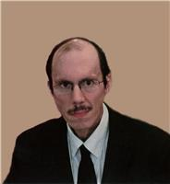
Core Members vs. Exposure
Levitation Outcome
Failure Partial Success Total
Success
High exposure
(Tom and Joe) 266 119 425 810
(32.8%) (14.7%) (52.5%) (100%)
Low exposure 67 32 194 293
(John N., Leroy, (22.9%) (10.9%) (66.2%) (100%)
Ivan, Sean)
Chi square = 16.56
df=2
p = .00025

Slide 55
Results of Exploratory Analysis
The interaction hypothesis predicted that second half rates should be greater than first half rates. This did not occur.
Participants tended to experience PK decline
This finding supports Lucadou/trickster predictions

Slide 56

Exploratory Investigations
Marge and Leroy: patterns within SORRAT experience; failed to support interaction theory
Ann: husband effect
John Neihardt: decline associated with experimental efforts
Dick: major decline effect (Skyrim decline)

Slide 57

Exploratory analysis:
Wax/Wane Patterns
2 strings of 6 consecutive successes,
5 strings of 7 successes
strings of: 10, 11, and 15 successes.
2 strings of 6 failures
1 string of 7 failures
Extremely improbable (less than .001.)
Example: Easter Sunday poltergeist

Slide 58

Field Observations
Field observations imply that psi has sentient, trickster qualities involving disruptions of the collective consciousness
These disruptions have dreamlike characteristics

Slide 59

Hobson’s Model of Consciousness

Slide 60

Sleep/Wake Cycle

Slide 61

Group PK and Dreams
J. Allen Hobson: Dreams
(1)Dreams often feature intense emotions
(2)Dreams are often disorganized and illogical
(3)Dream content is accepted without question
(4)People often experience bizarre sensations
(5)Dreams are often difficult to remember
SORRAT phenomena
(1)Phenomena stimulate intense emotions (belief and skepticism)
(2)Phenomena are often incoherent, illogical, disorganized
(3)Participants report unexplained, bizarre perceptions
(4) Participants accept the validity of bizarre observations
(5) Trance utterances are often coordinated, explanatory, or predictive of PK. Those, in trance, do not remember their perceptions or utterances.

Slide 62

Revised theory
In harmony with the ritual healing theory, the evidence implies that propensity for PK experience varies among participants.
The ritual healing theory provides replicable hypotheses: it predicts specific correlations and relationships associated with shamanism – a process that has shaped human consciousness.
SORRAT seems to exemplify an alternate consciousness that is thwarted when exposed to regular consciousness.
Alternate consciousness may be related to unusual variations in the sleep/wake cycle (Hobson, 2001). The cholinergic chemical system, governing dreams, may affect group PK, giving it trickster qualities.

Slide 63

Conclusions
Analysis supported the facilitation/suppression theory
Exploratory results reduced faith in the interaction theory
Group PK has trickster qualities, parallel to dreams. This suggests it is affected by cholinergic chemical systems

